Slide 1



Group Project 2
- REAL ESTATE ANALYSIS -
- www.domain.com.au API -
Qasse, Joanna, Navid, Christian and Chris.

Slide 2

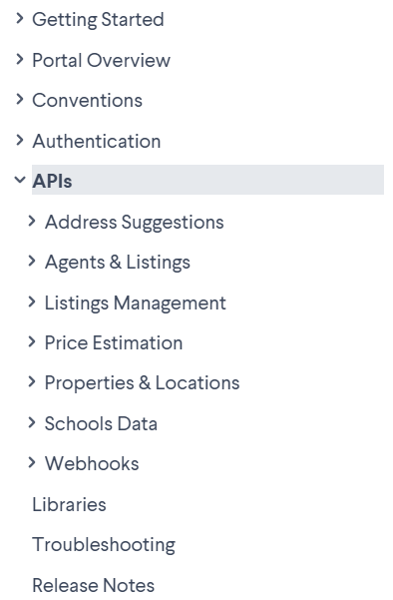
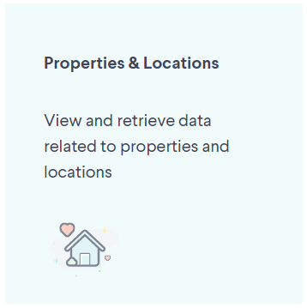
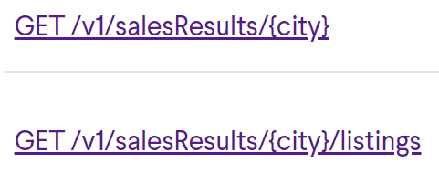
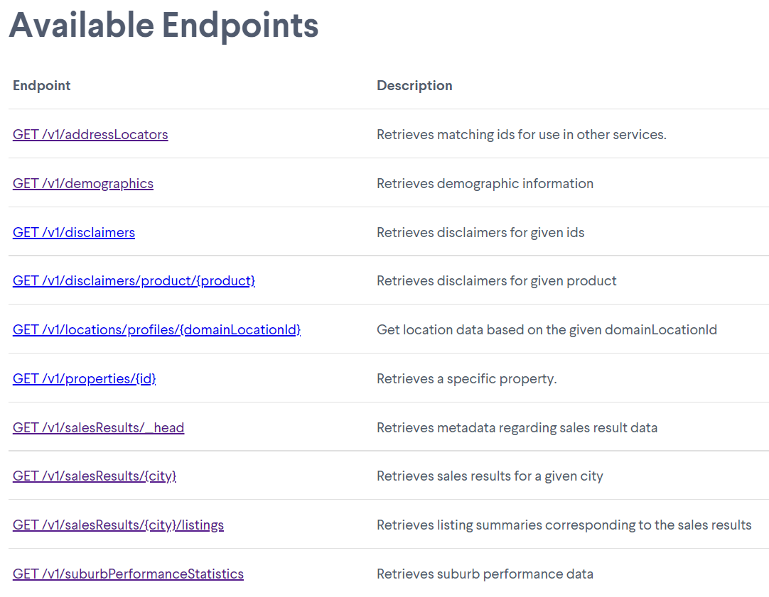
We chose to use these:
CB

Slide 3

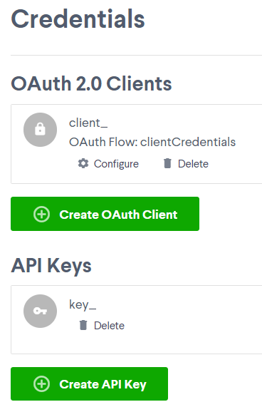
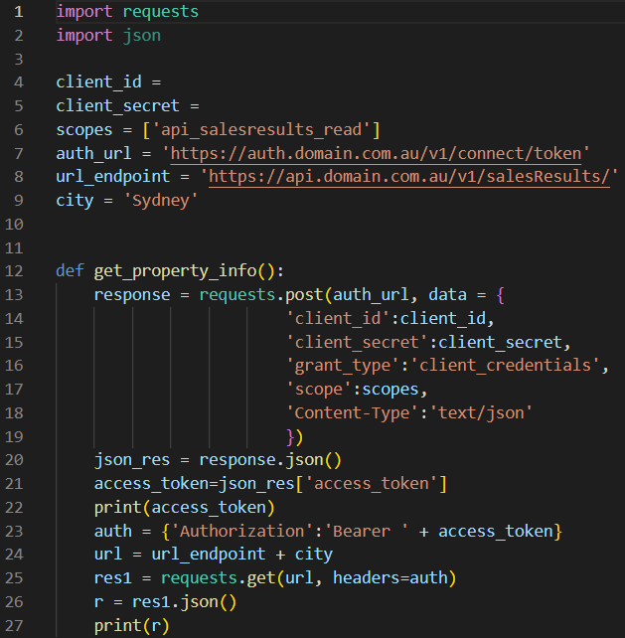
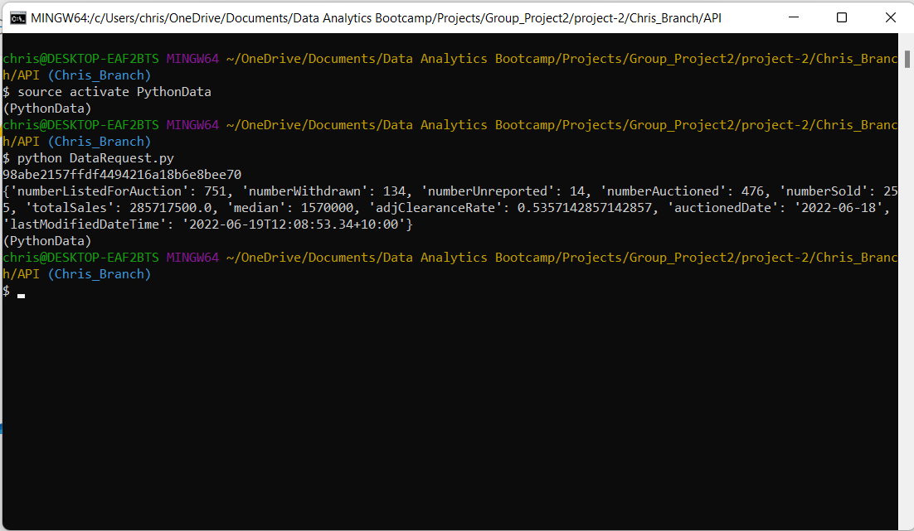
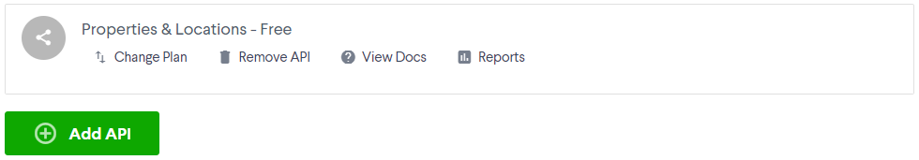
Running the ‘DataRequest’
code in GitBash:
JSON data
CB

Slide 4
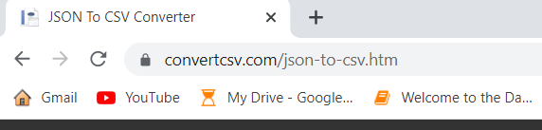
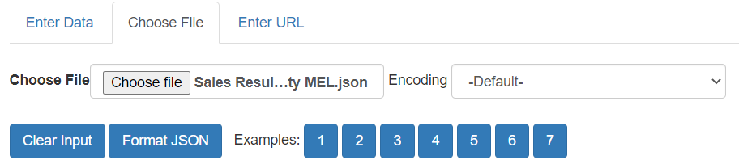
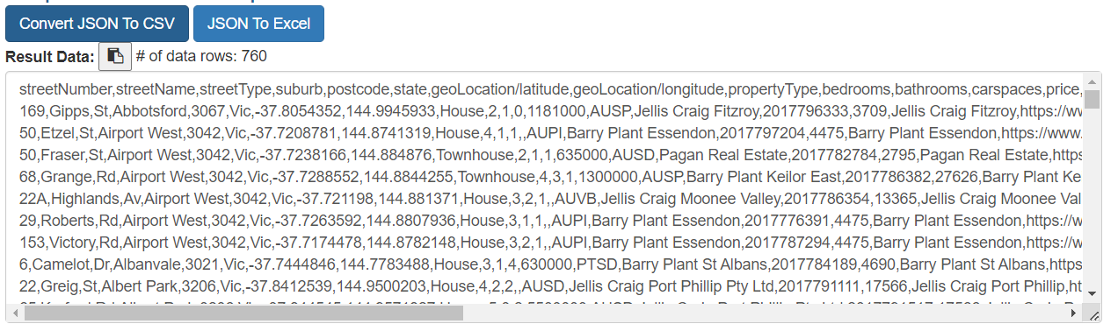
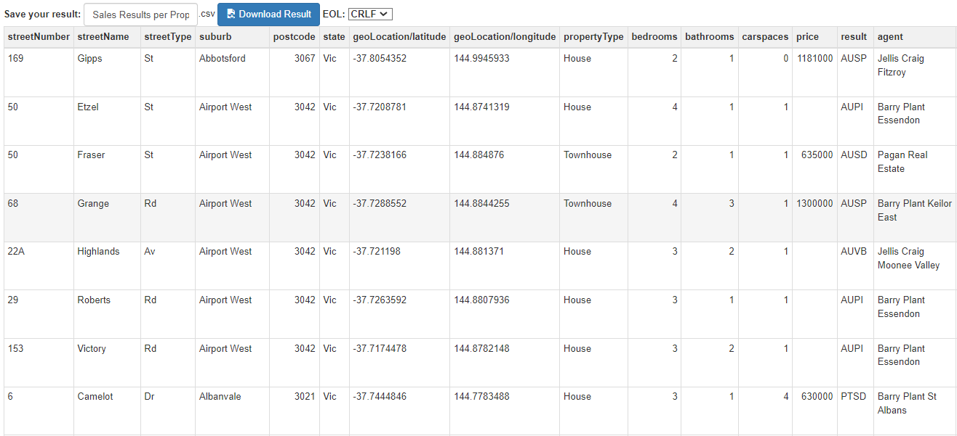
The website above enabled us to convert JSON data from the Domain.com APIs to CSV format.
This conversion enabled the data transfer to Mongo DB.
CB

Slide 5

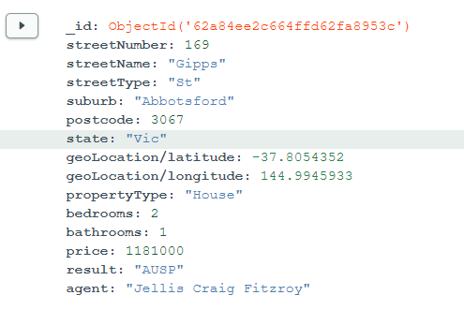
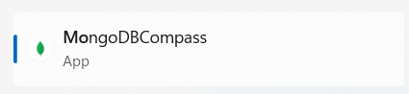
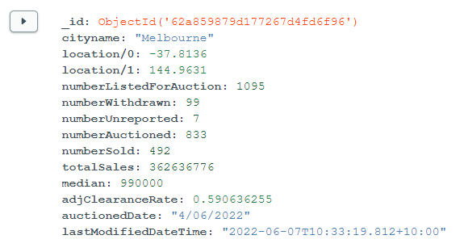

projects
projects2
Our project required the use of 5 databases in total.
Q

Slide 6
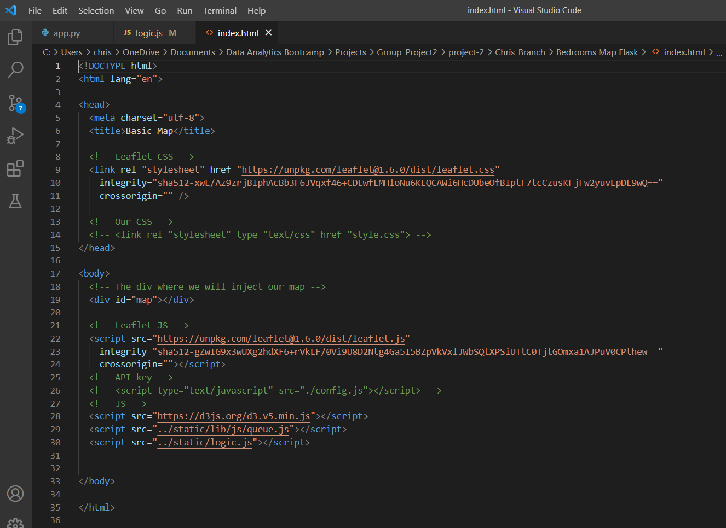
Creating an Interactive Web-Based Visualisation:
Step 1 : Create an html file
Reference the relevant ‘style’ packages.
Create a division to house the visualisation.
Make links to scripts including config and logic files.
CB

Slide 7
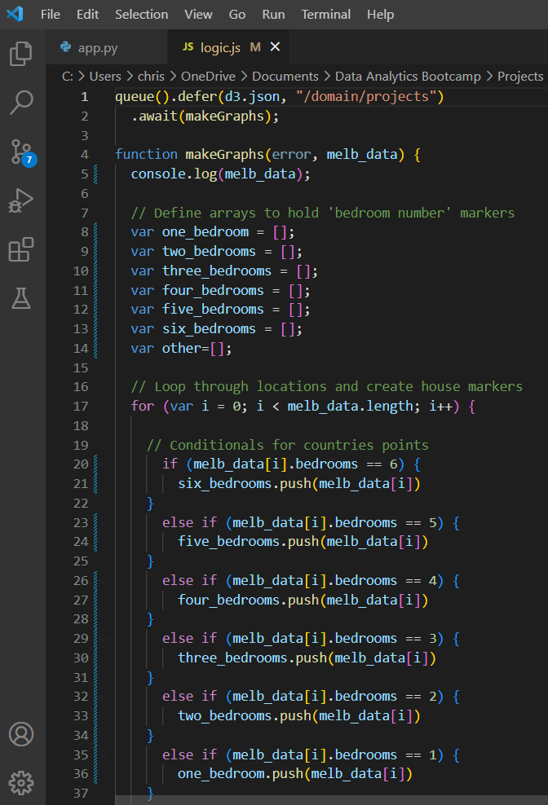
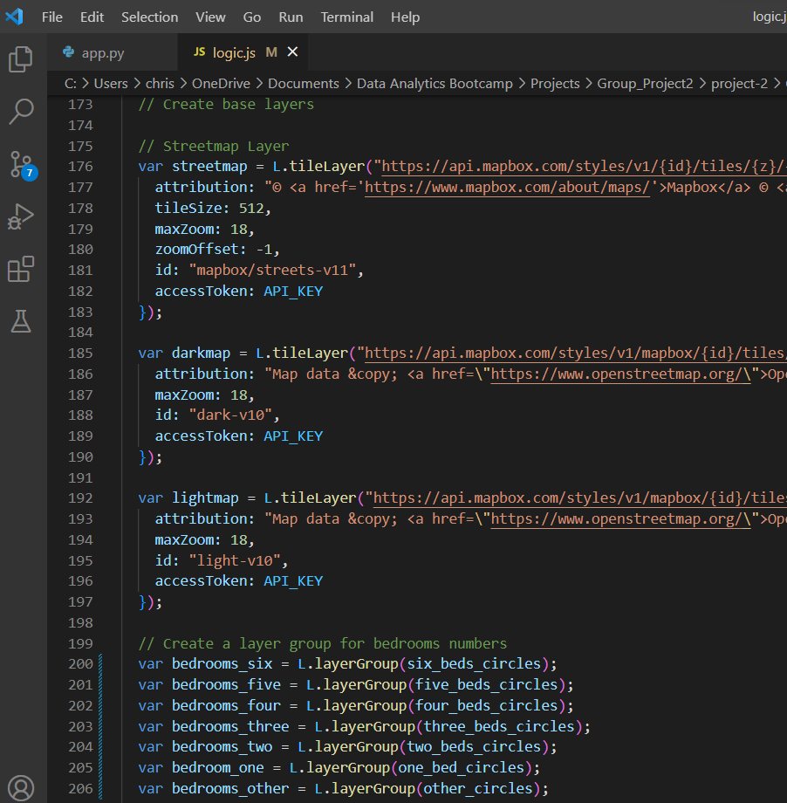
Creating an Interactive Web-Based Visualisation:
Step 2 : Create a JavaScript file
Import Mongo DB data
Create a function which build a map
Build map layers
Build marker layers

Slide 8
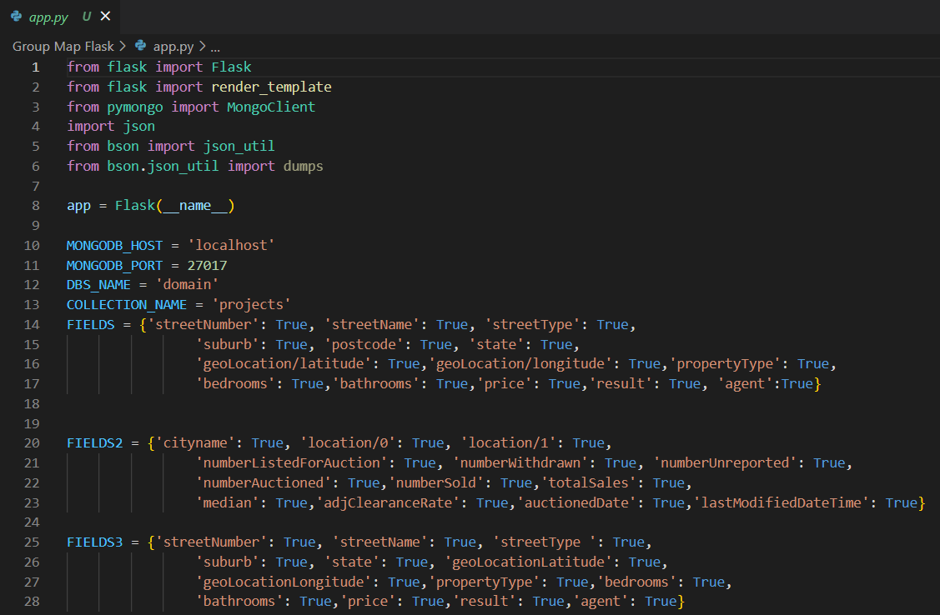
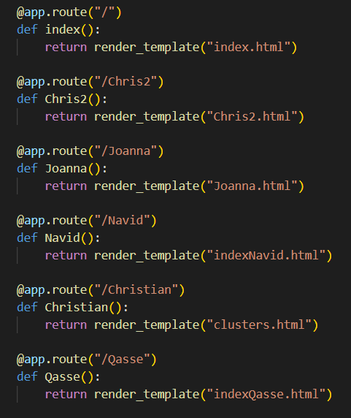
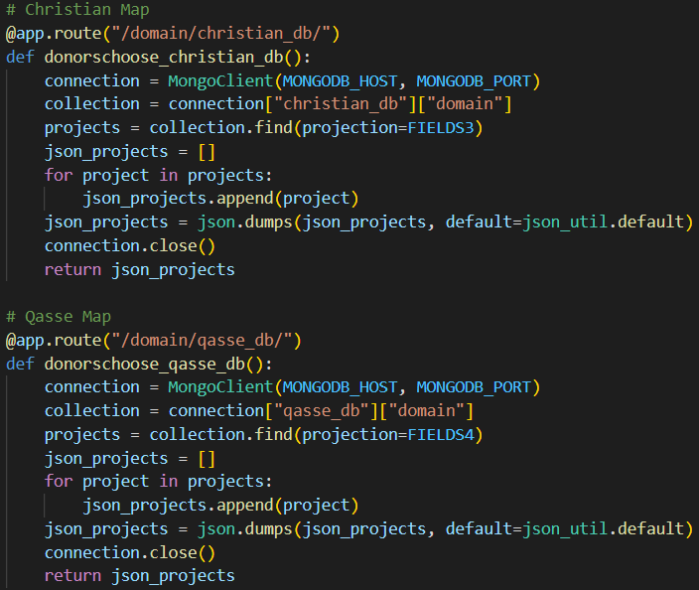
Creating an Interactive Web-Based Visualisation:
Step 3 : Create an app.py file which runs your visualisation (and others)
Create a connection to the Mongo database.
Create ‘landing page’ code which runs the index.html file when the app is launched.
Other routes that the user can explore on the Flask app.

Slide 9
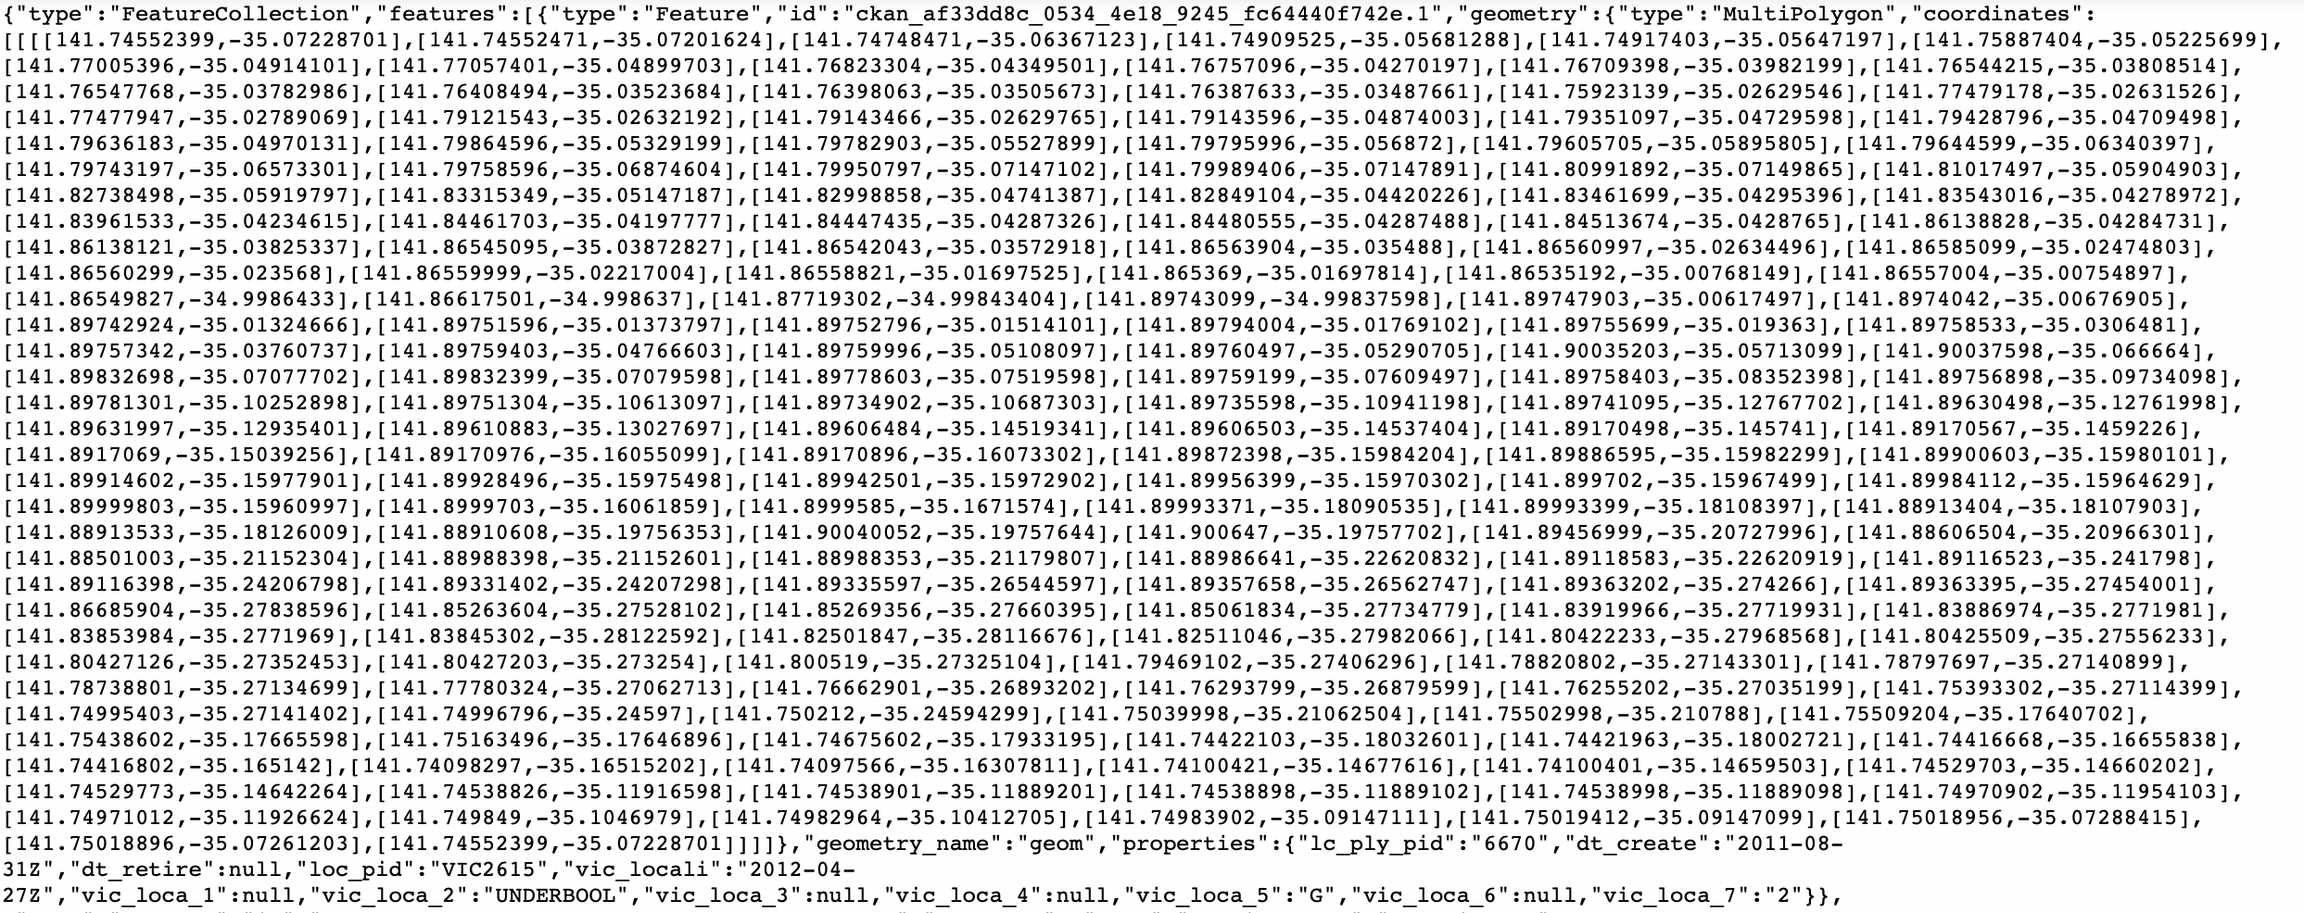
Data wrangling
How to display colours on the heatmap using geoJSON data
without quantitative data?
suburb
Coordinates: list of lists

Slide 10

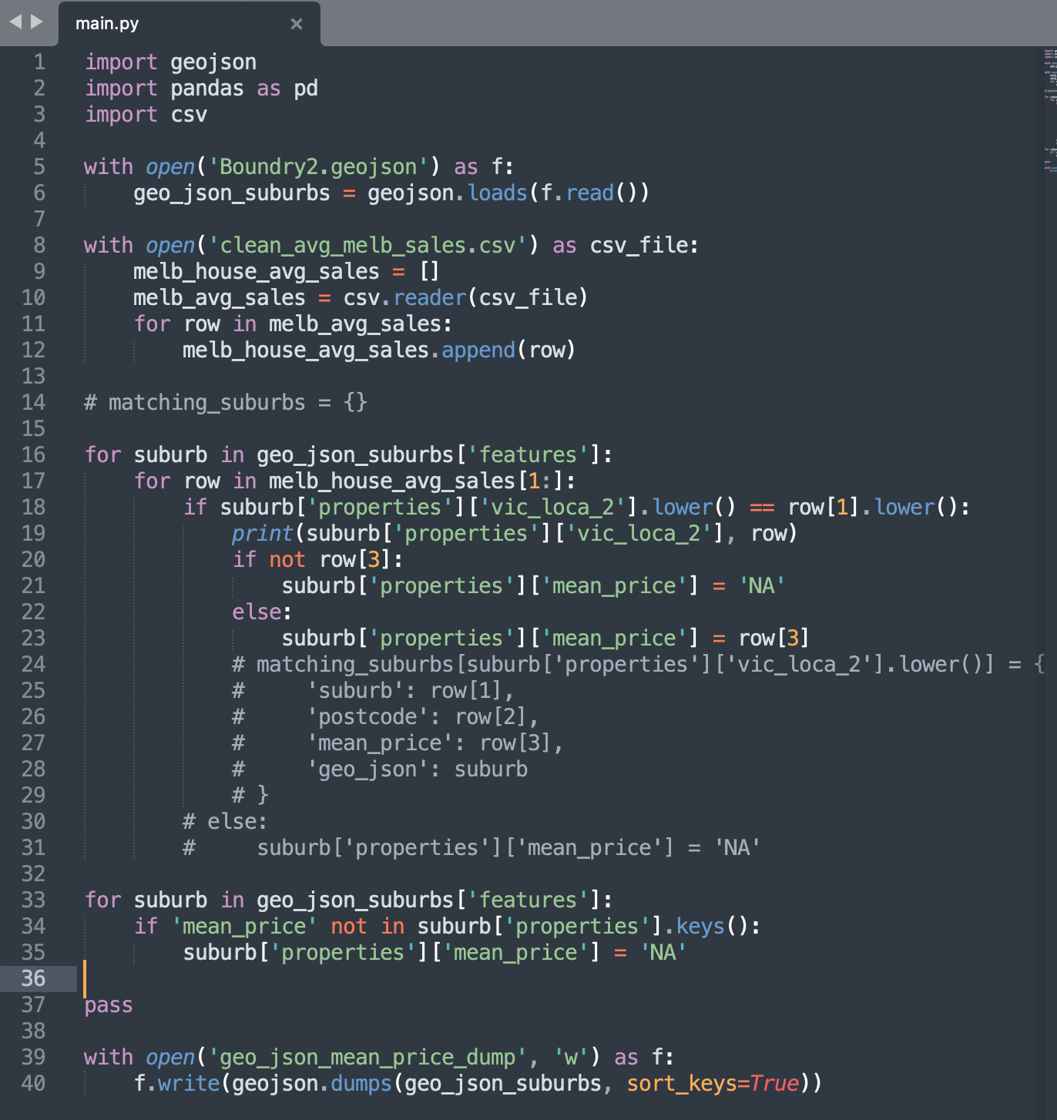
Merging geoJSON file with quantitate data -> not trivial
if number_of_rows in file_csv == number_of_rows in geoJSON:
print(“Go ahead use QGIS”)
if number_of_rows in file_csv != number_of_rows in geoJSON:
print(“prepare for sweating over coding”)

Slide 11
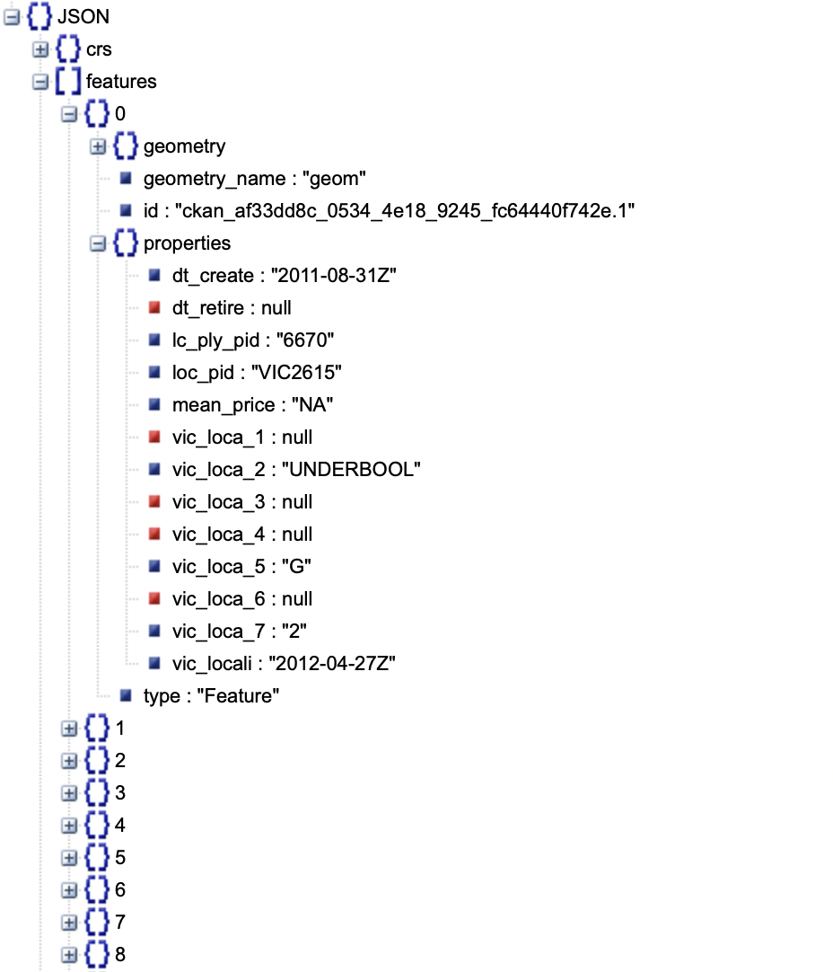
Chloropleth ready file
Polygon coordinates[coordinates]
Attribute value [mean_price]
Suburb [vic_loca_2]

Slide 12

Suburb Popularity in Melbourne and Price Expectations
This research seeks to explore:
In-demand suburbs of Melbourne in the property market.
How realistic buyers' expectations of the market are.
This Photo by Unknown author is licensed under CC BY-SA.

Slide 13
Hypotheses
The hypotheses tested in this research are:
It is more feasible to find and purchase a property in the north and east of Melbourne.
Buyers have lower expectations of the market prices than what they eventually pay for a property.

Slide 14
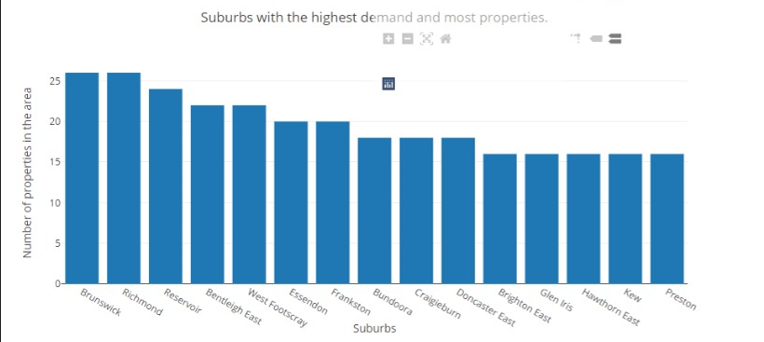
The bar graph demonstrates:​
Areas with highest listings are mainly concentrated in north, north-east and north-west of CBD.
All North: 135 listings
East: 74 listings
In-demand suburbs not in north or east:
Brighton East(South - 26)
Bentleigh East ( south - 24)
Frankston (South - 20)
West Footscray (West – 22)

Slide 15
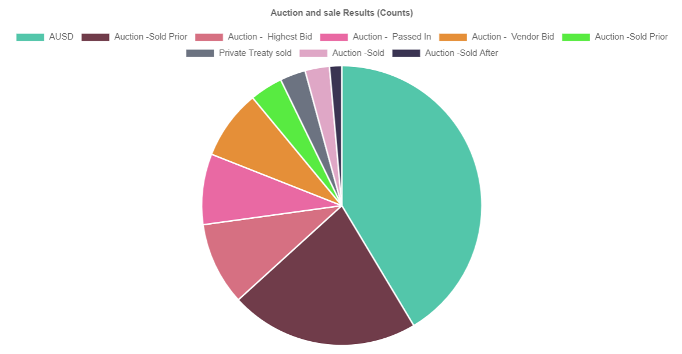
The pie chart displays:
More than 75% of the market sales take place in auctions.
It is very likely for a property to be sold at a higher price than the market since auctions are competitive.

Slide 16
Conclusions
According to the findings:
Purchasing properties in the north is the most feasible.
6 suburbs among the top 10
7 suburbs among top 15
East Melbourne is the second area for easy purchase.
1 suburbs in top 10
4 in the top 15
Home Buyers most probably have to pay higher than expected prices due to auction bidding wars.
>75% of the market properties sold in auctions

Slide 17

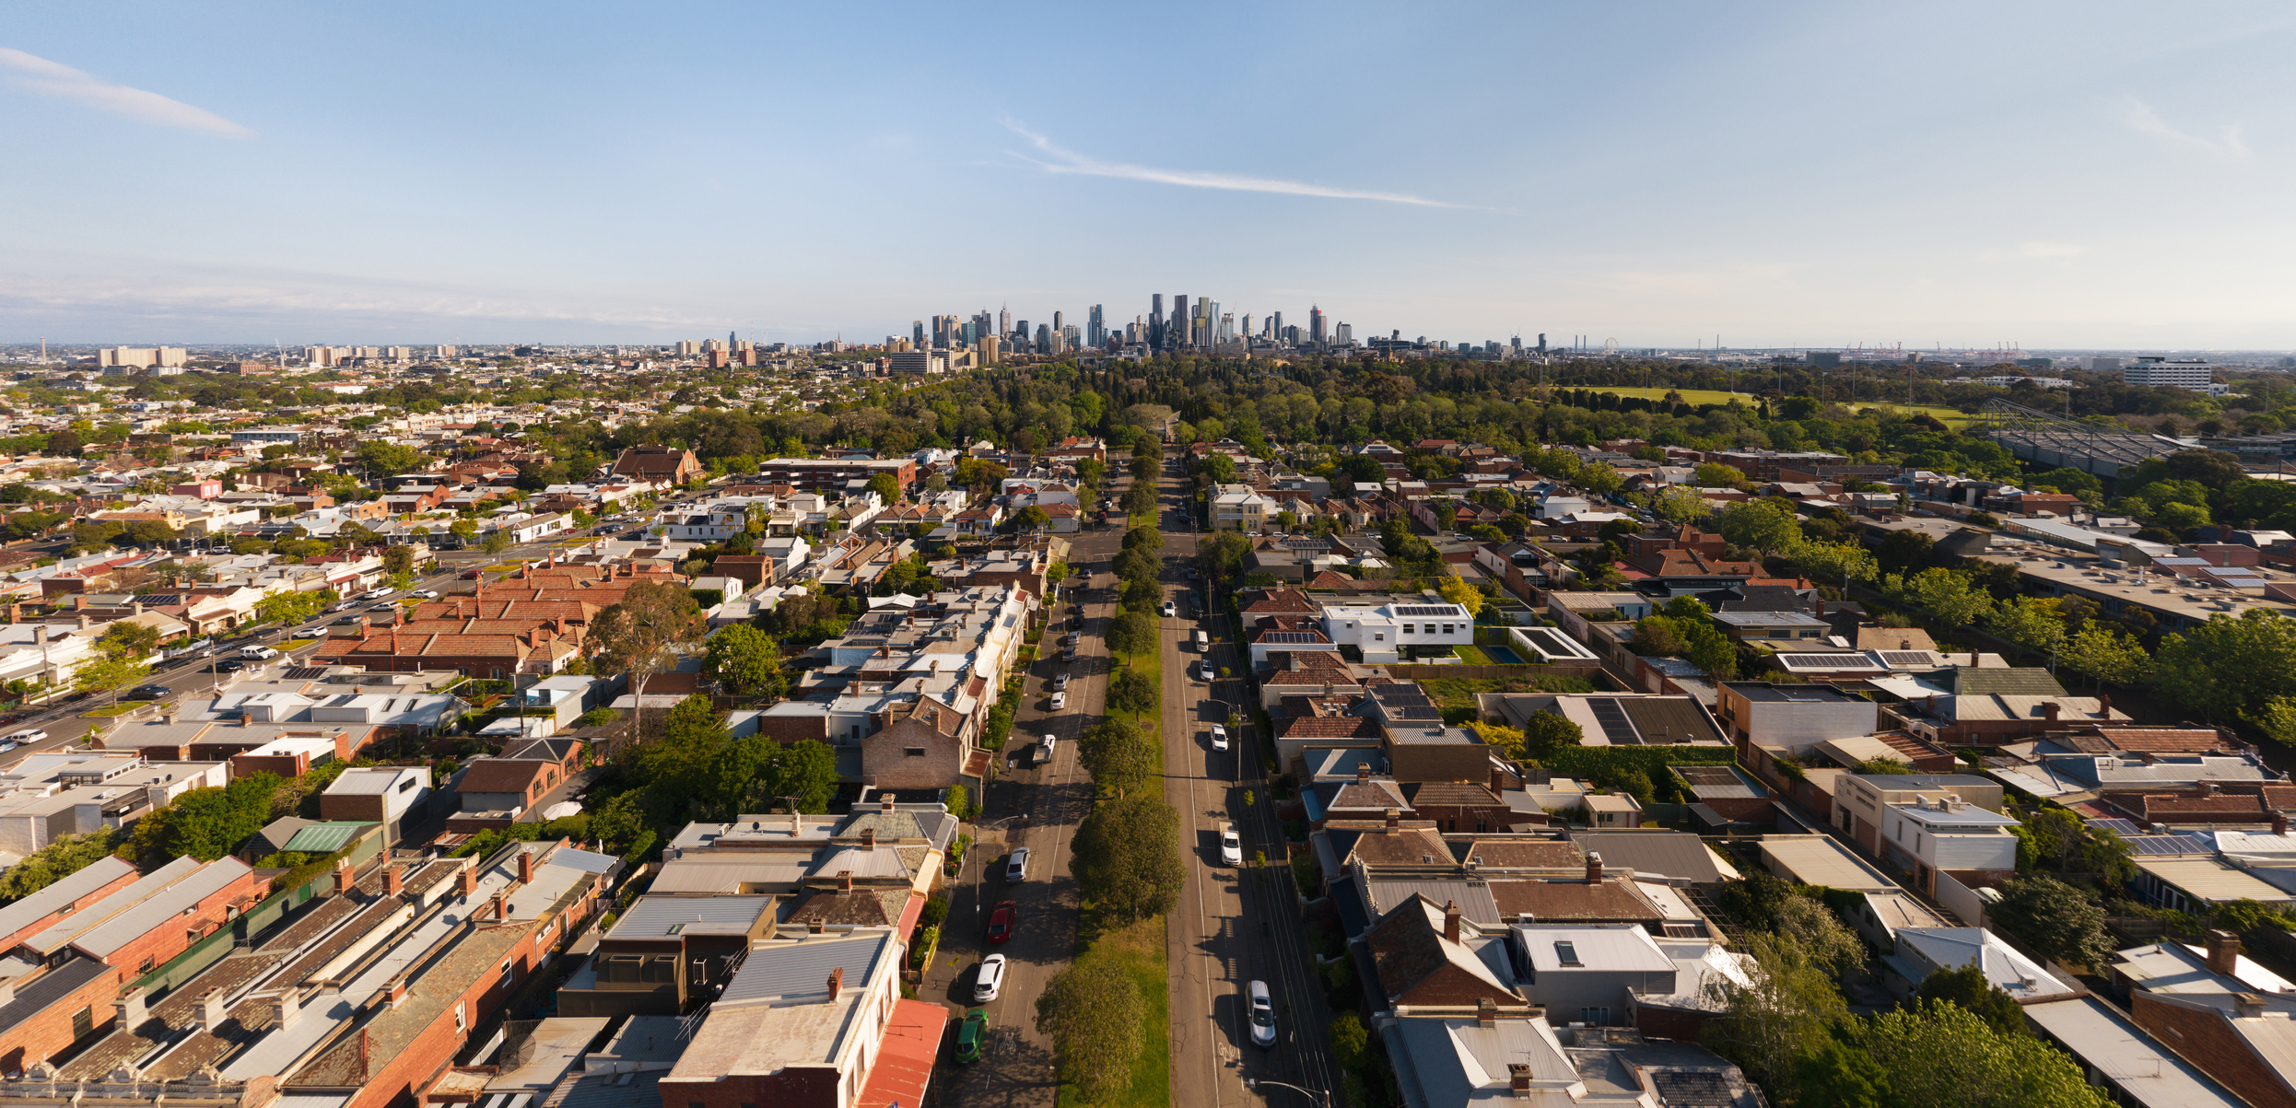
Which Melbourne suburbs made sales in the past week?

Slide 18
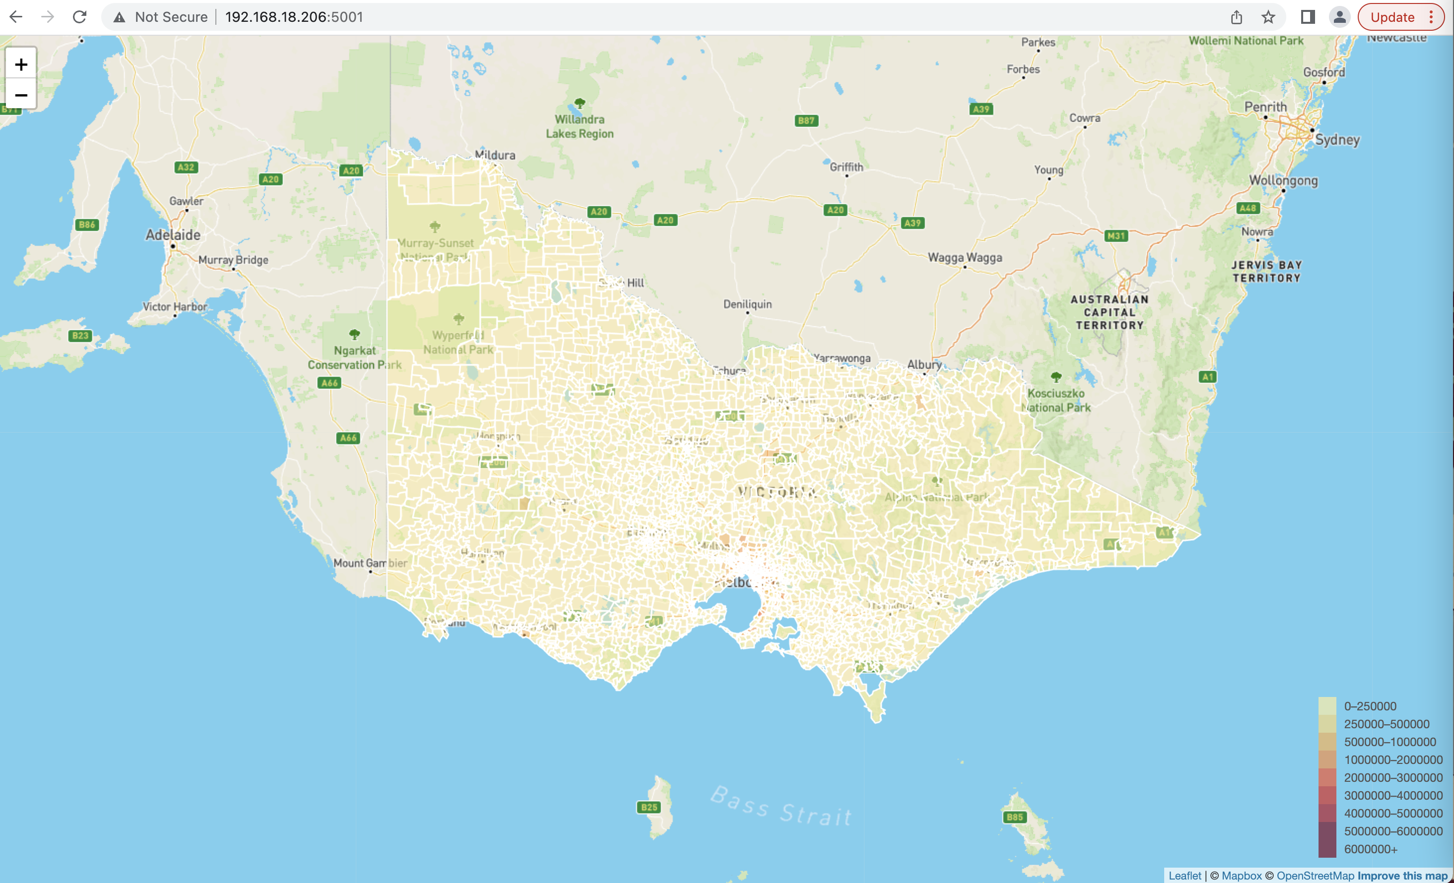
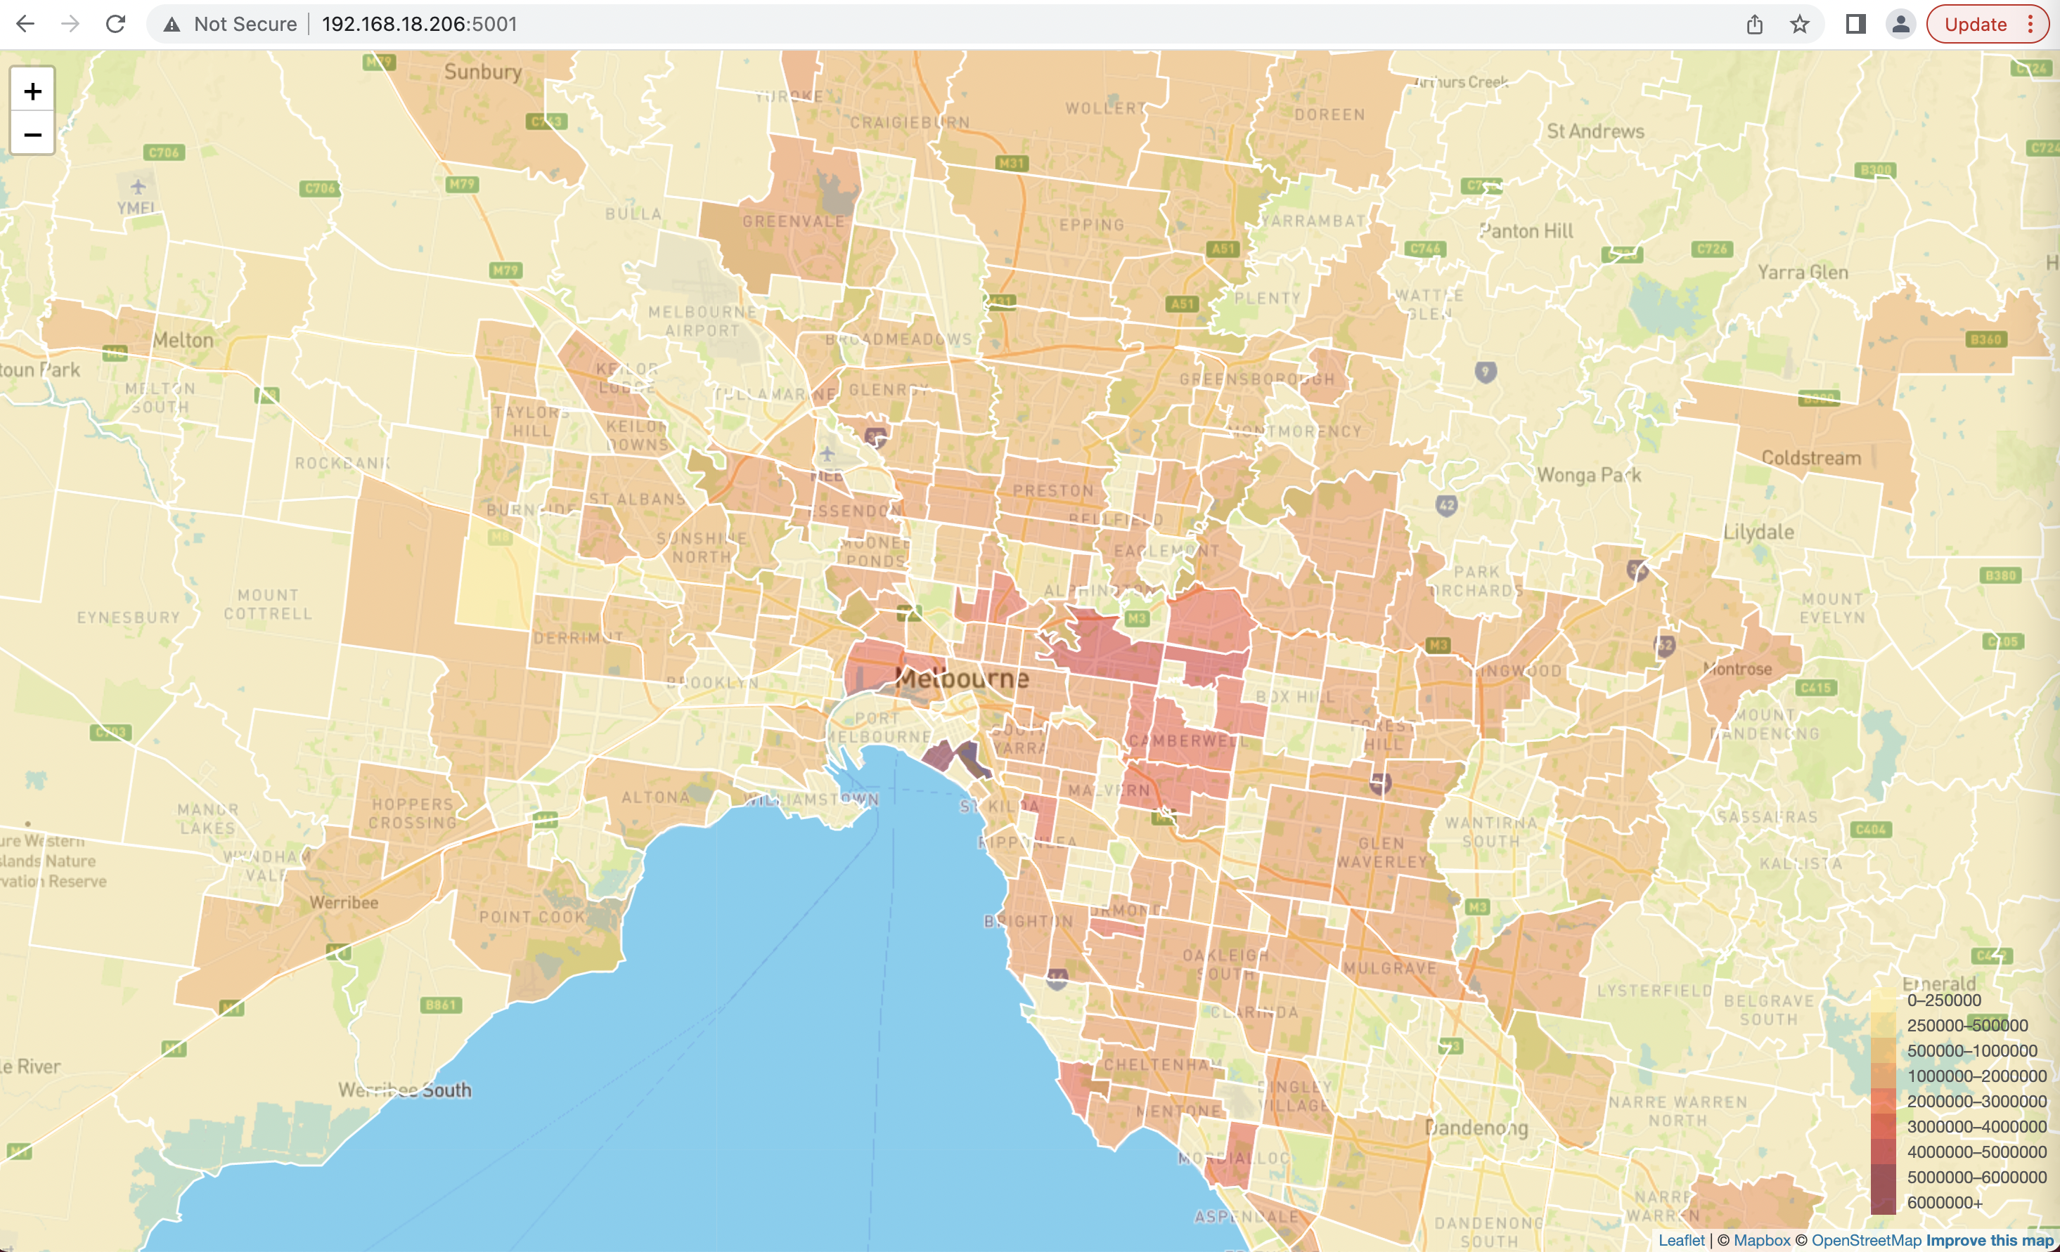
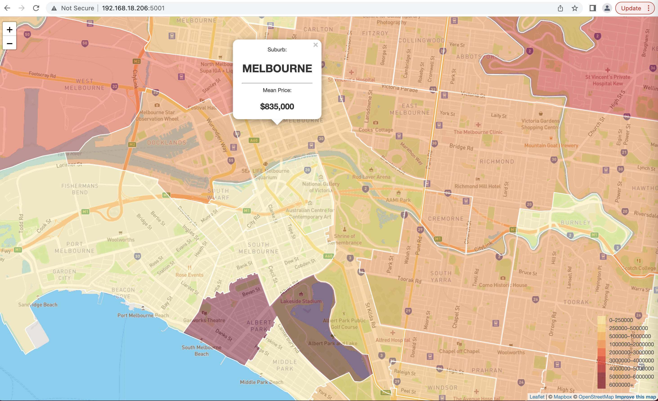
Displayed boundaries for nearly 3000 suburbs in Victoria
Heatmap representing the varying prices across the suburbs
Interactive visualization of median prices
Heatmap legend

Slide 19
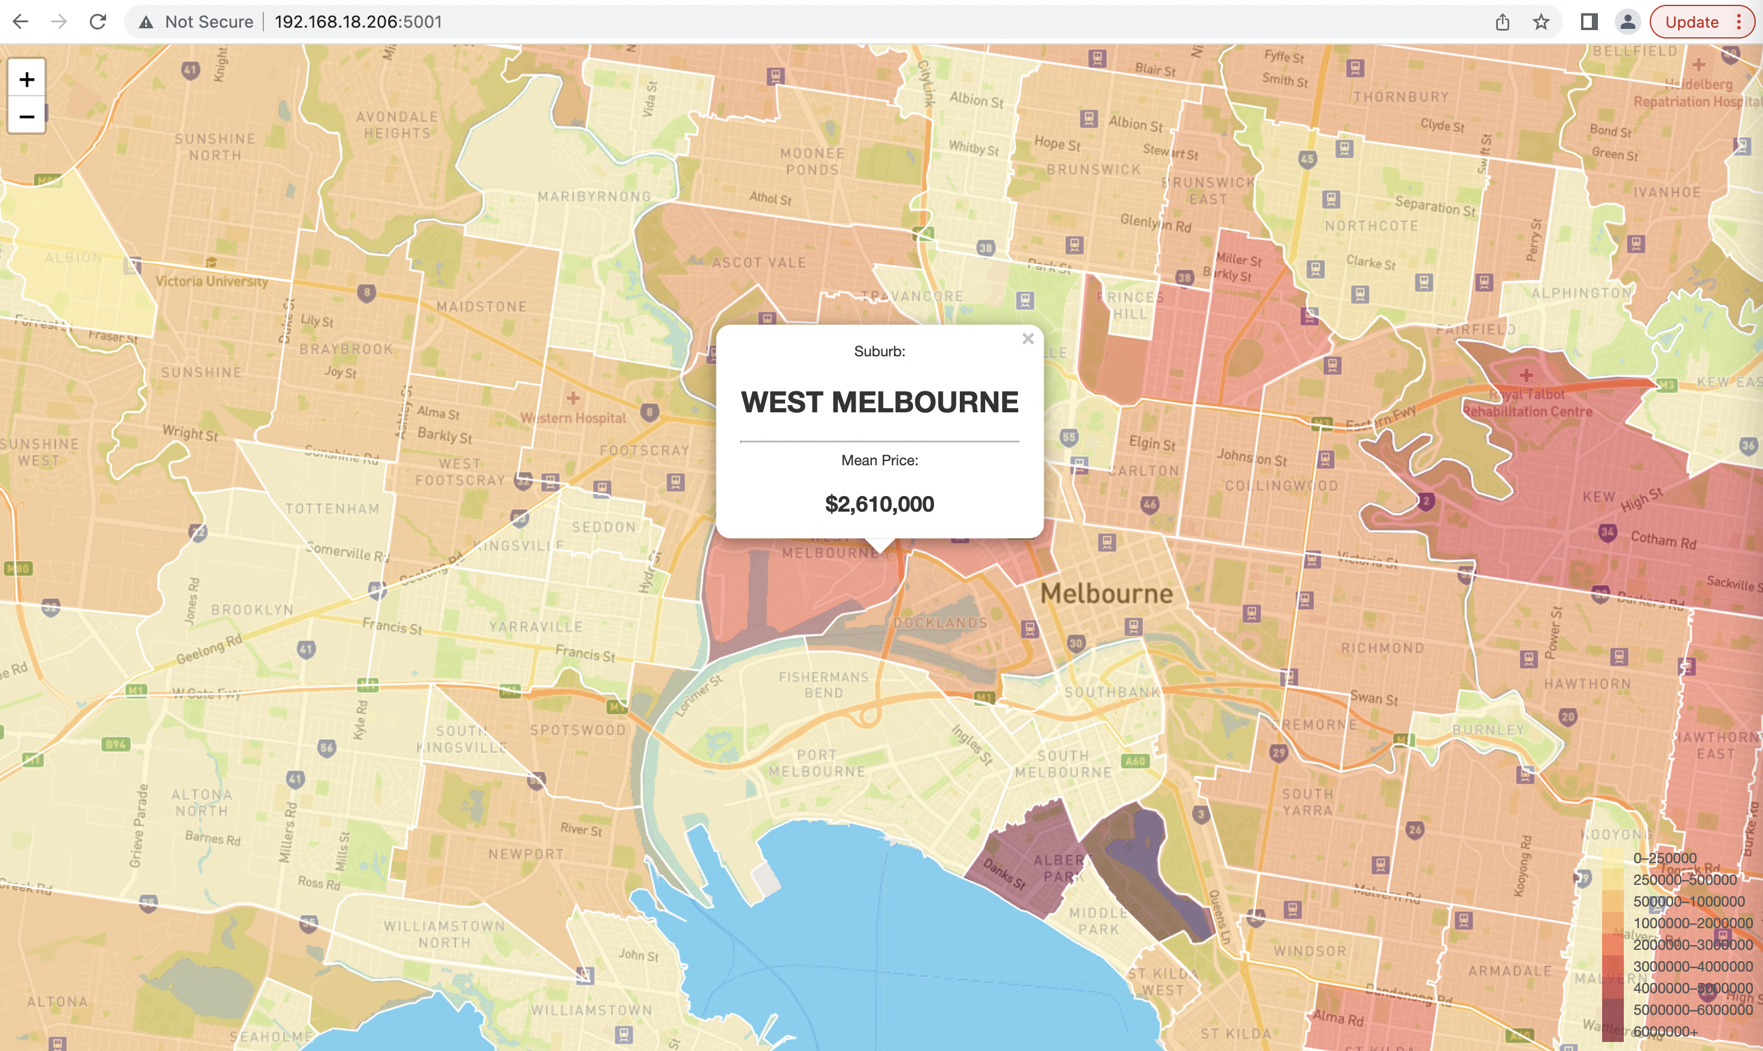
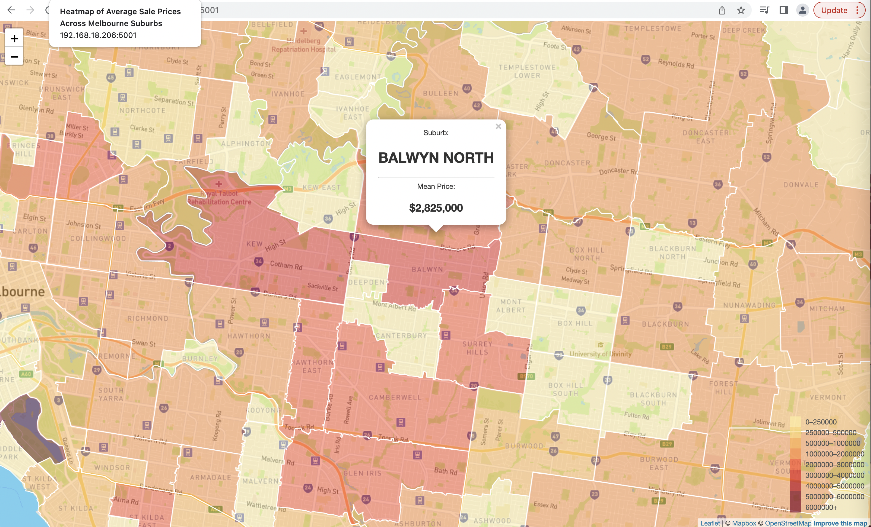
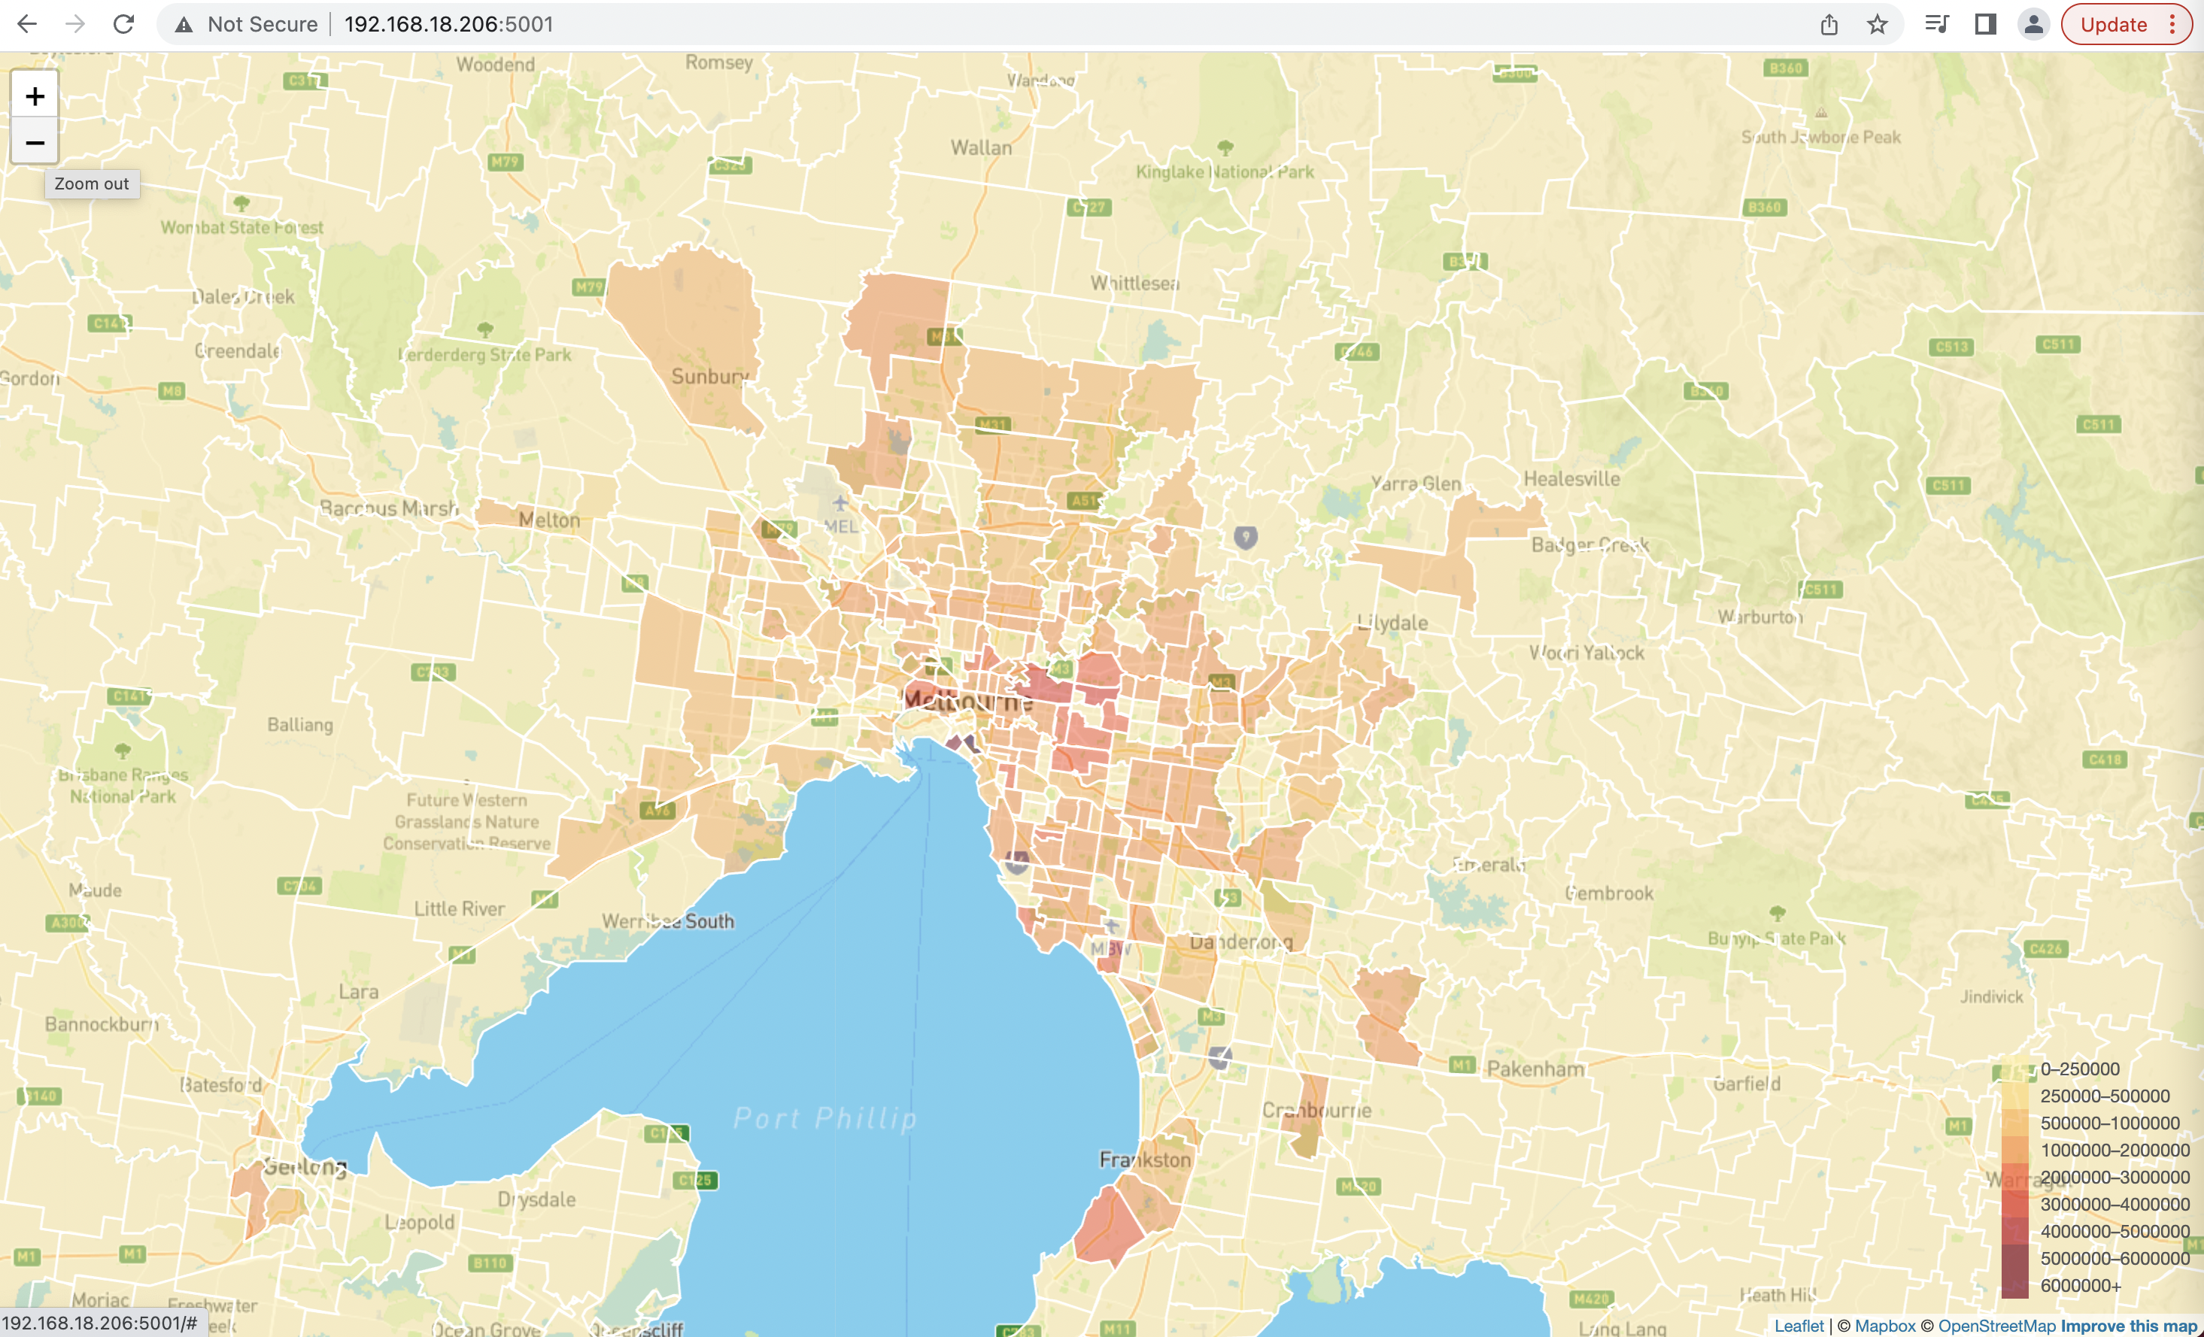
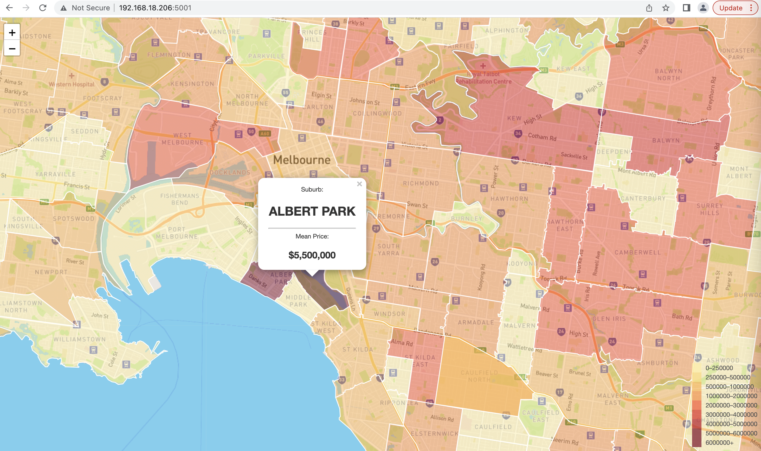
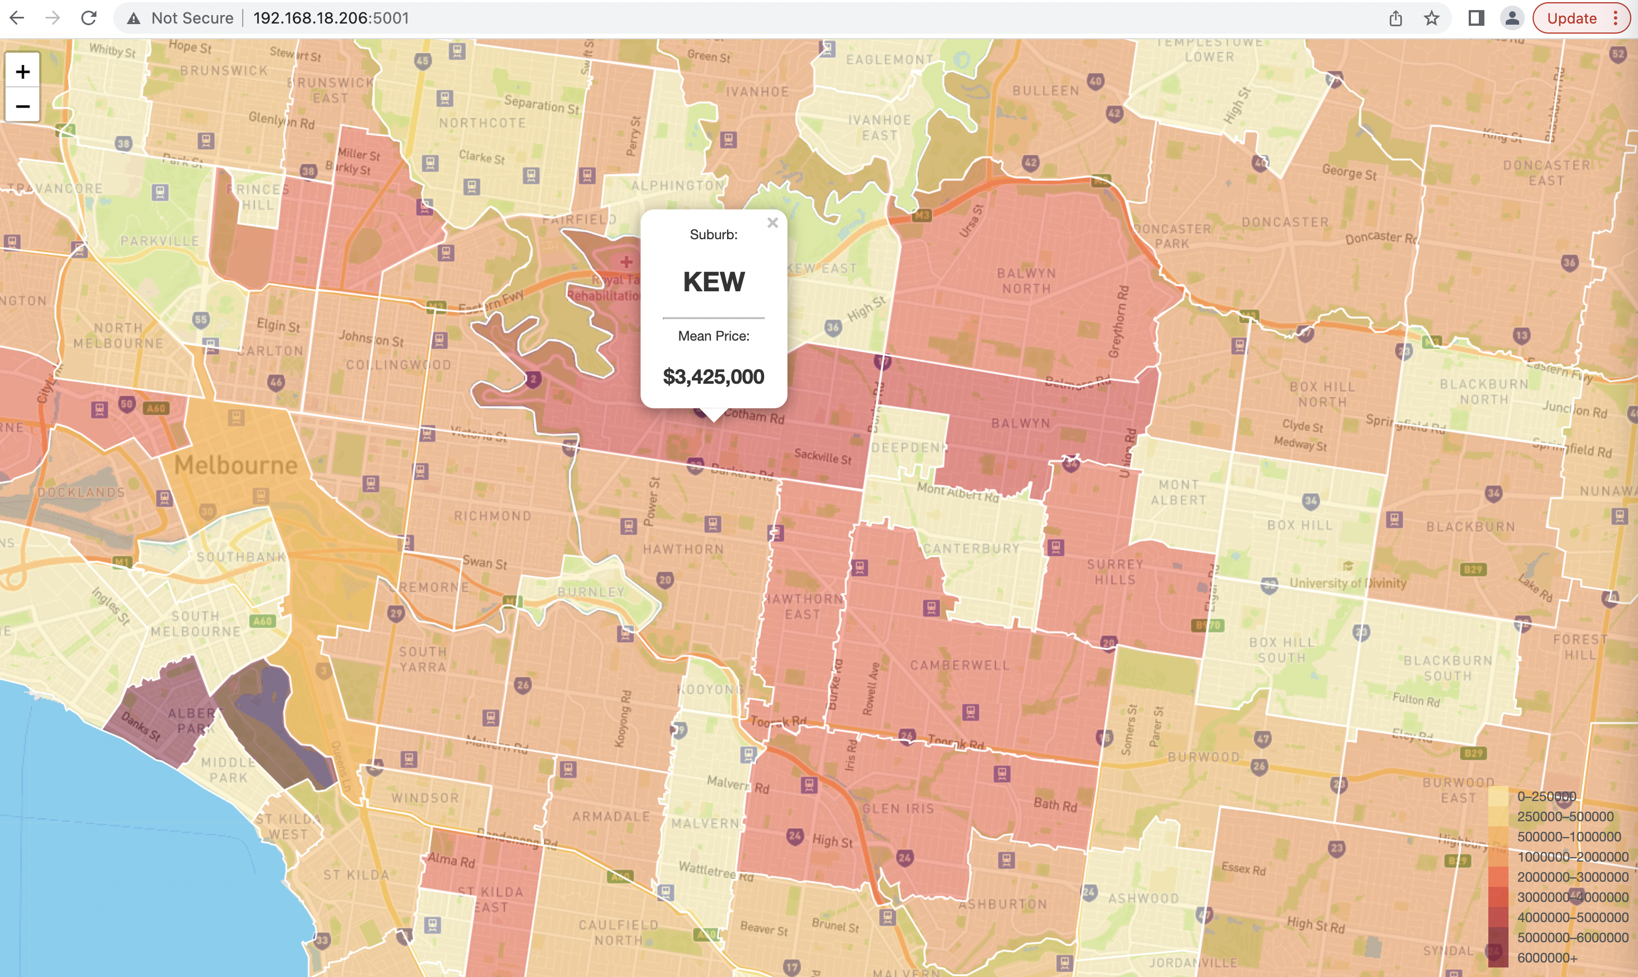
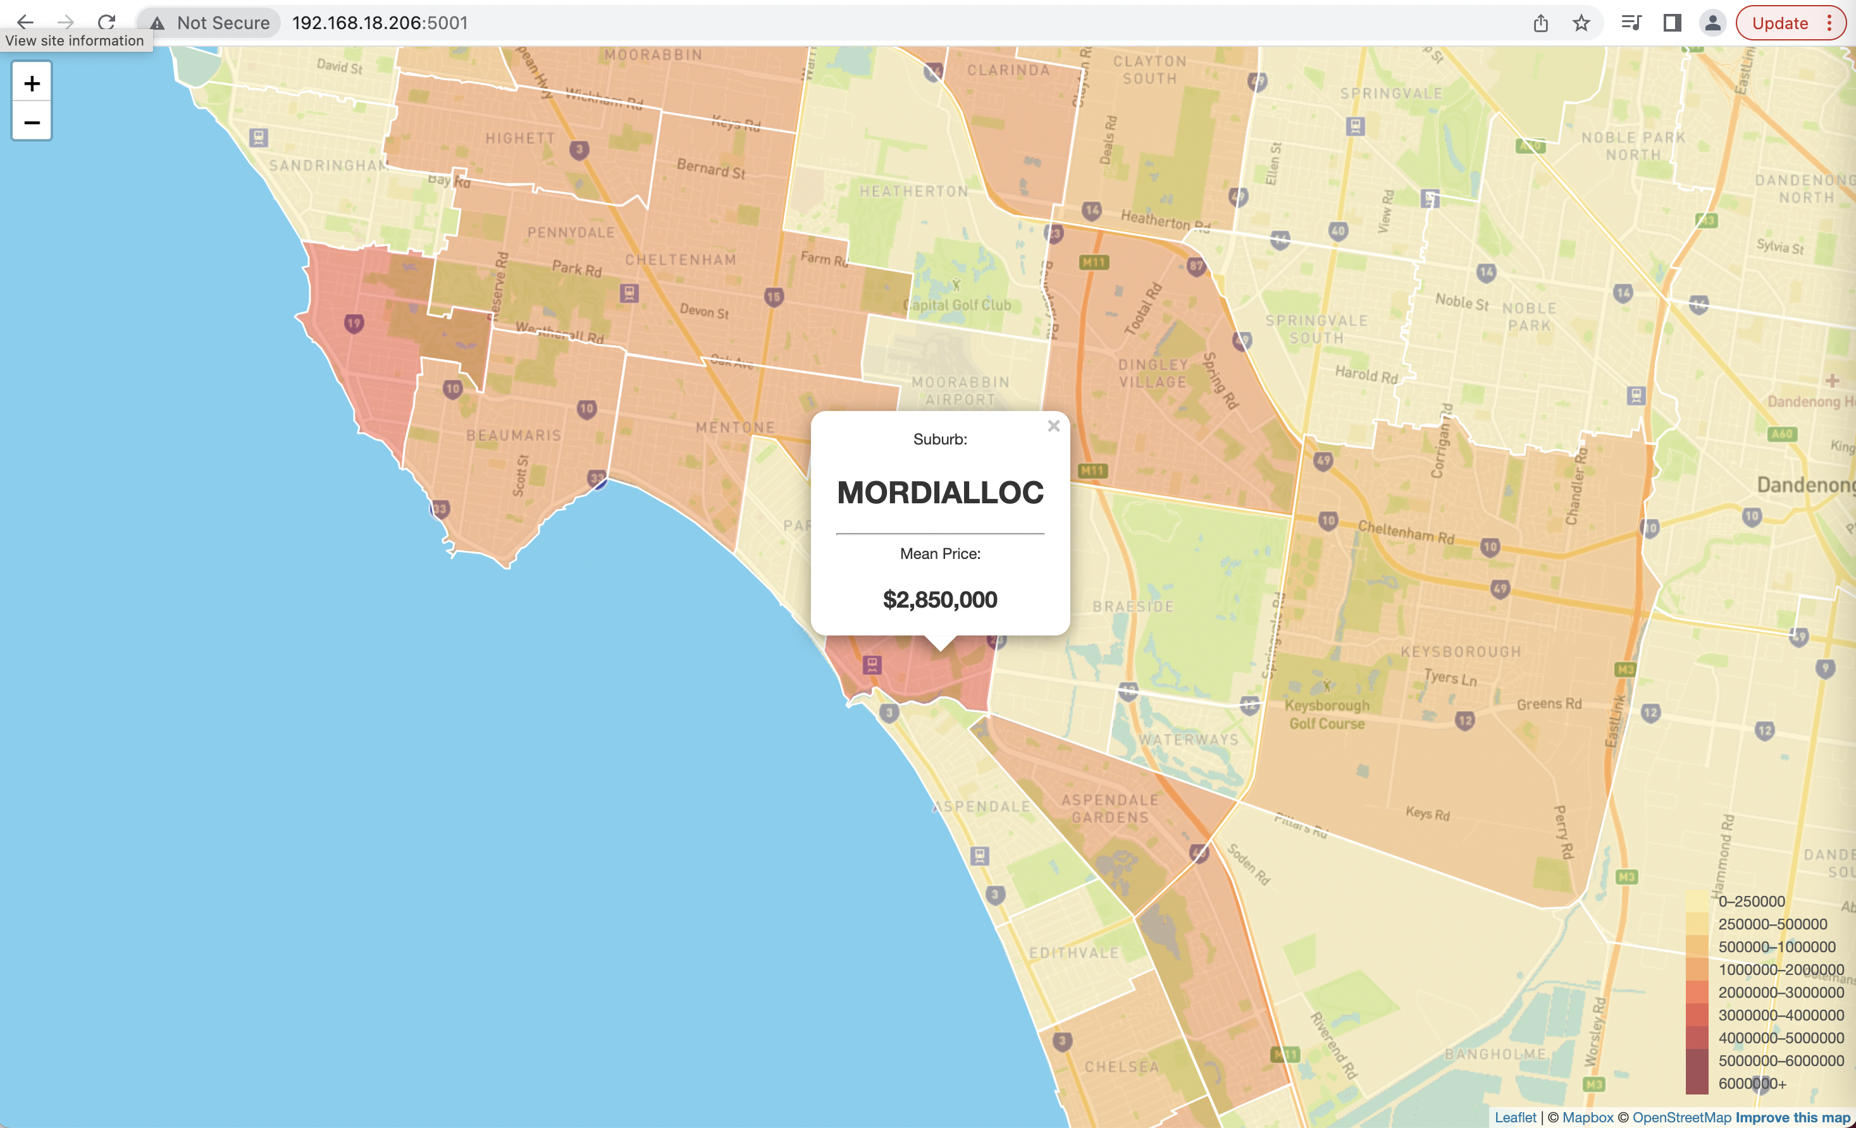
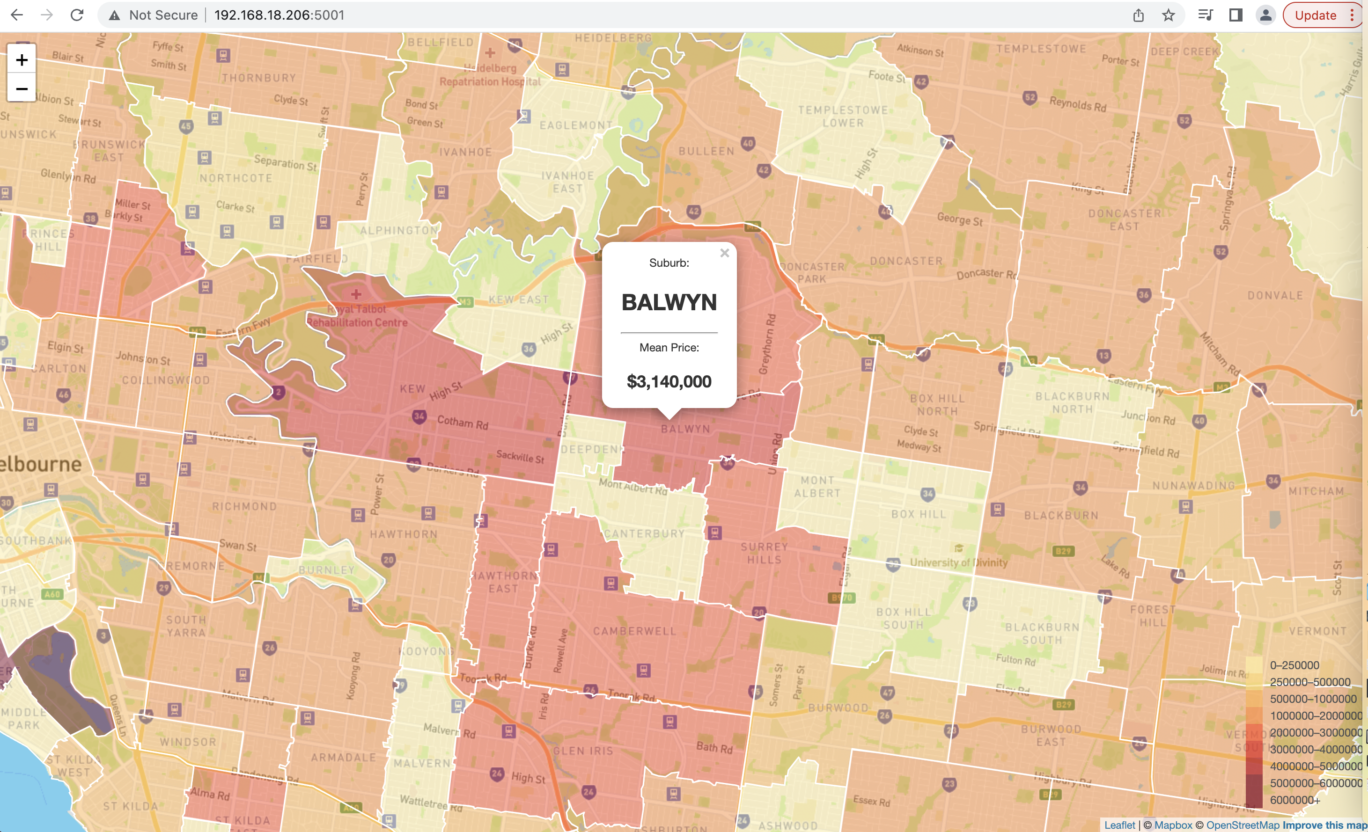
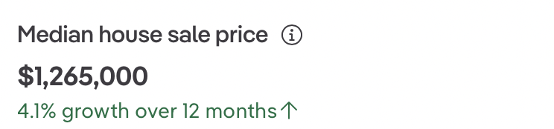
Findings:
Inner Melbourne suburbs sold most properties vs outskirts
Top 5 most expensive suburbs:
Albert Park $5,500,000
Kew $3,425,000
Balwyn $3,140,000
Mordialloc $2,850,000
Balwyn North $2,825,000
Hot spot:
West Melbourne $2,610,000

Slide 20
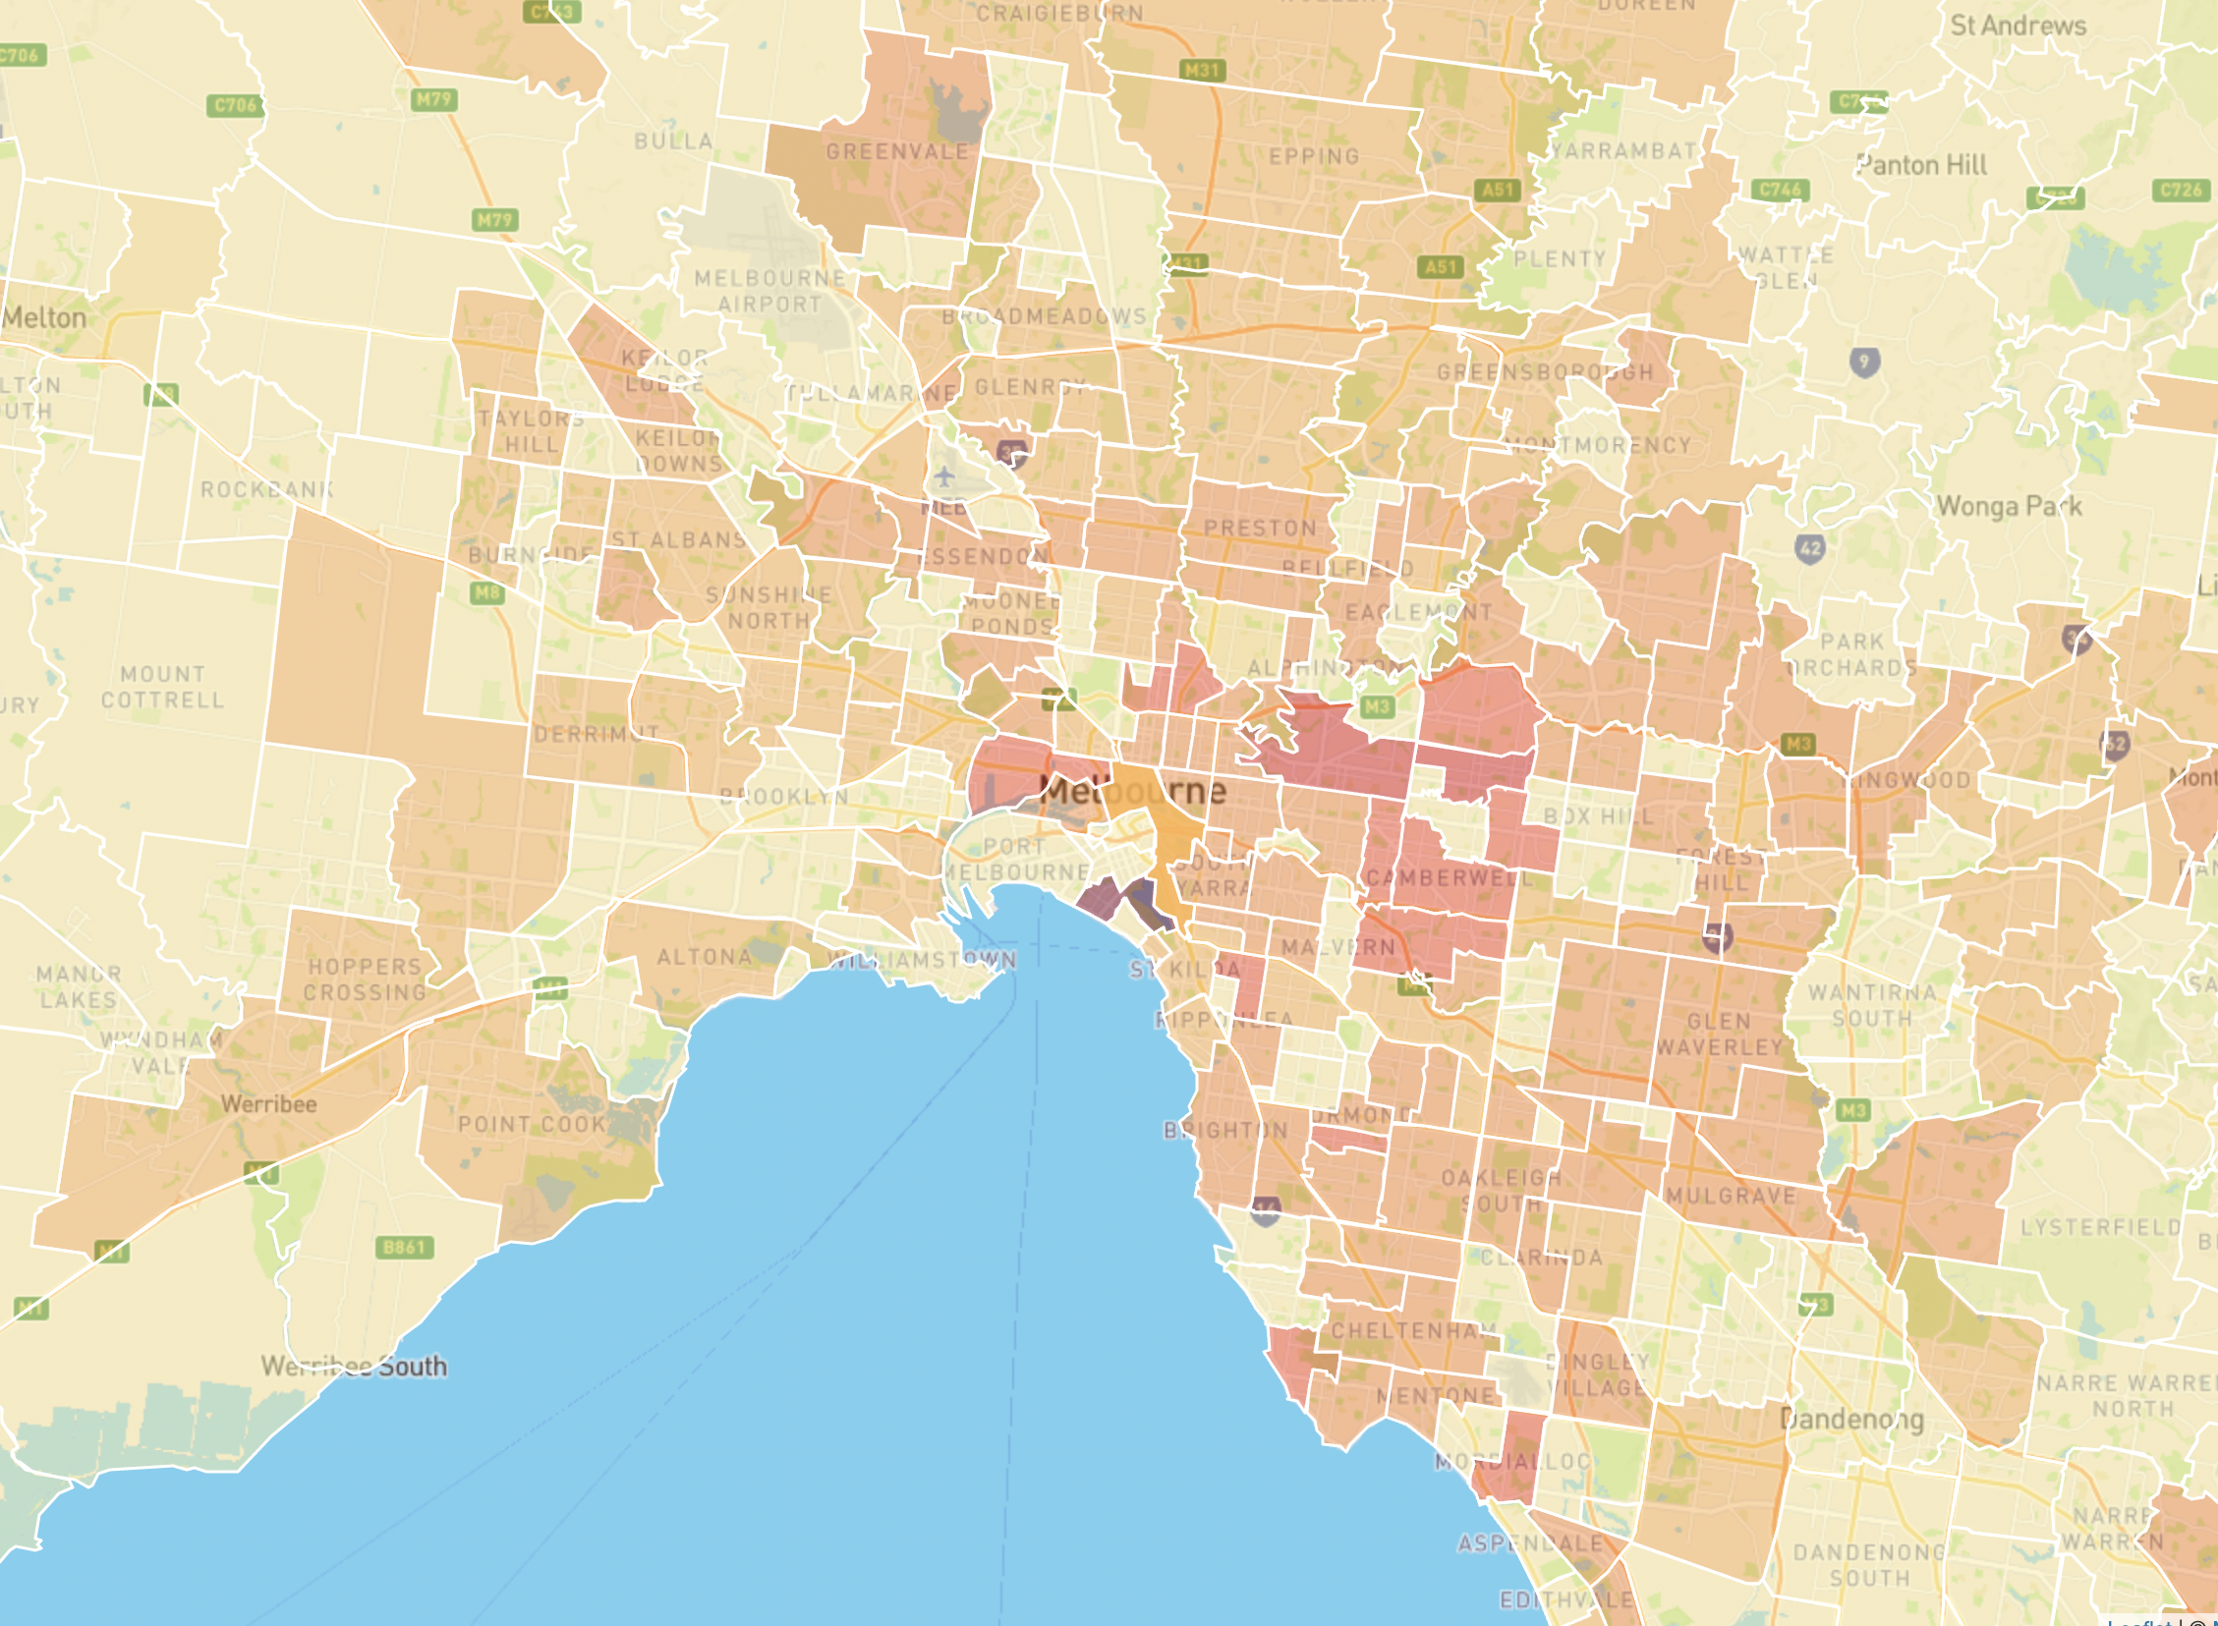
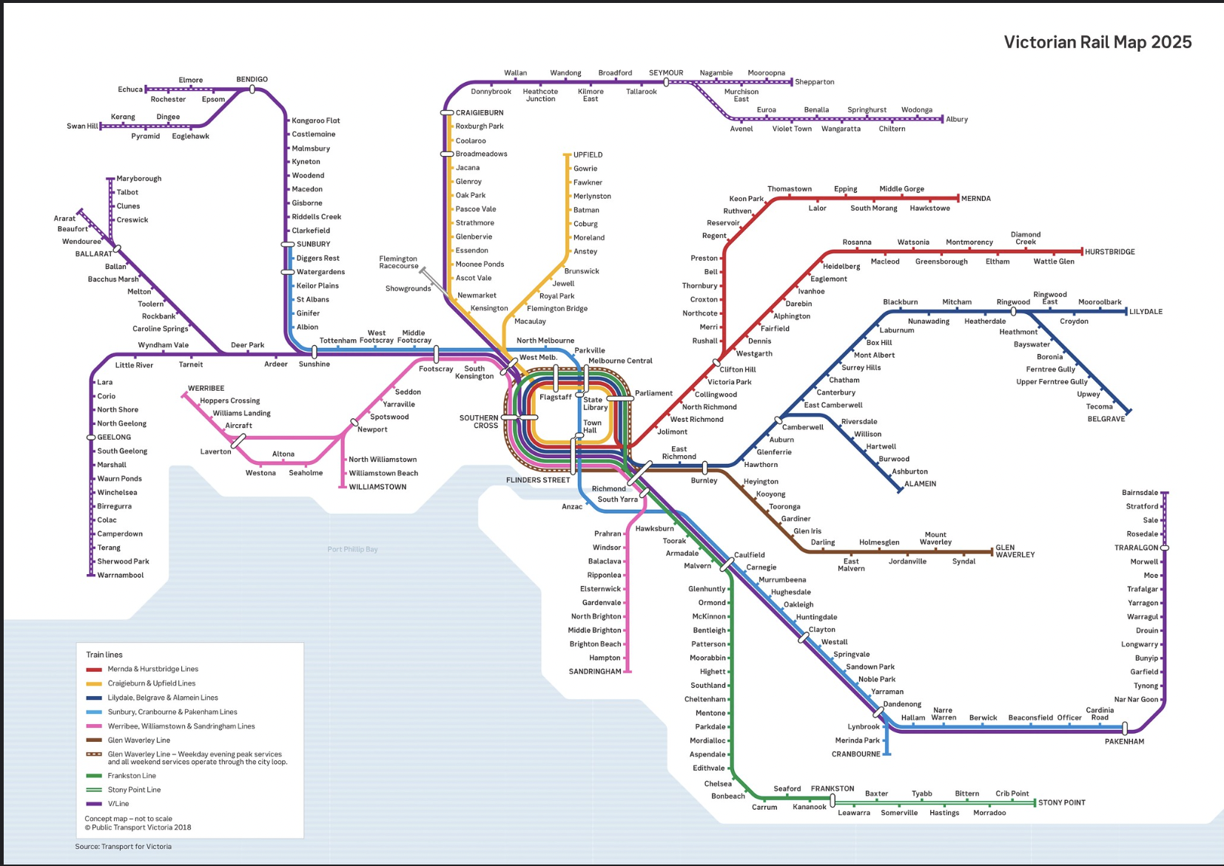
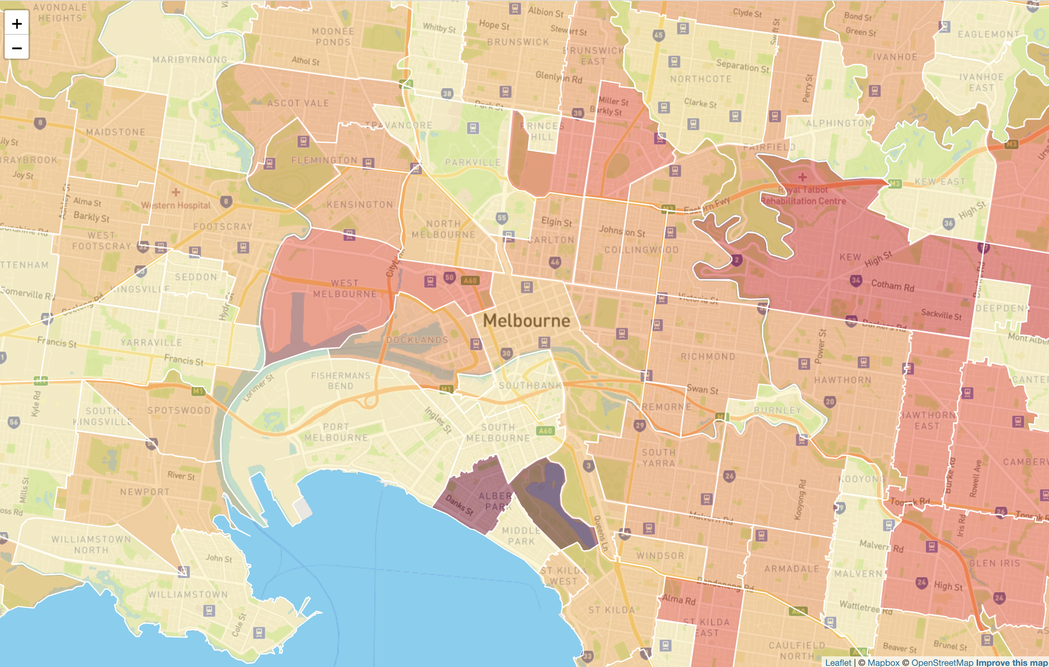

Does transport network and plans of improvements make suburb more desirable?

Slide 21
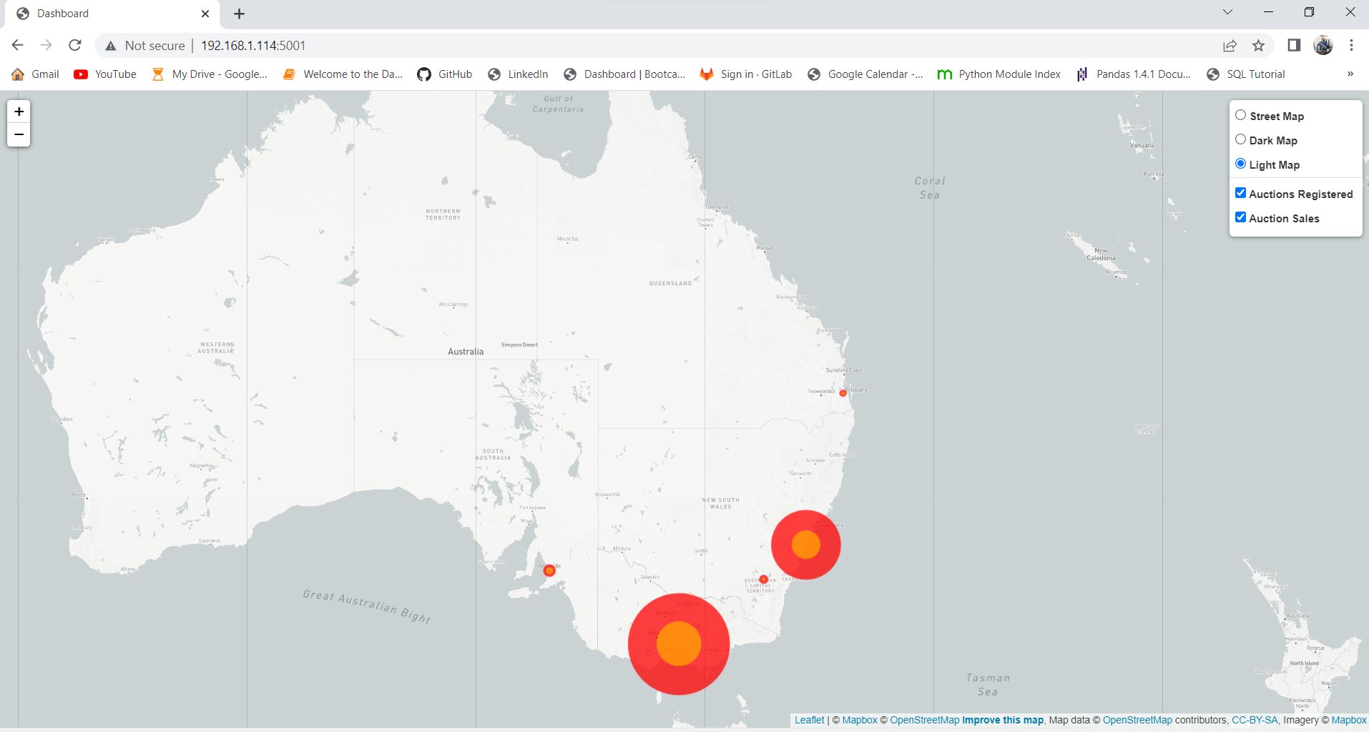
Visualisation 1:
Auction Clearance Rate Results – Eastern Seaboard Data
Hypotheses:
With the recent cooling in the housing marker we will observe a large discrepancy between auction numbers and sales in all major cities.
The effect will be felt largest in cities where housing prices are highest.

Slide 22
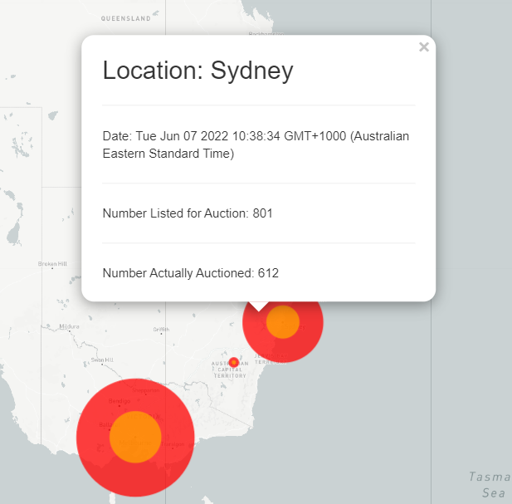
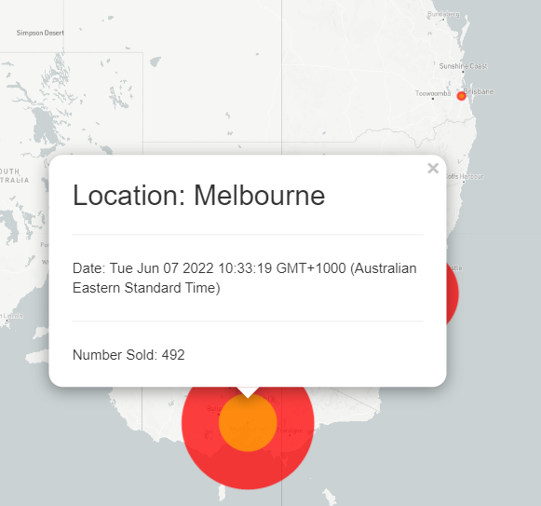
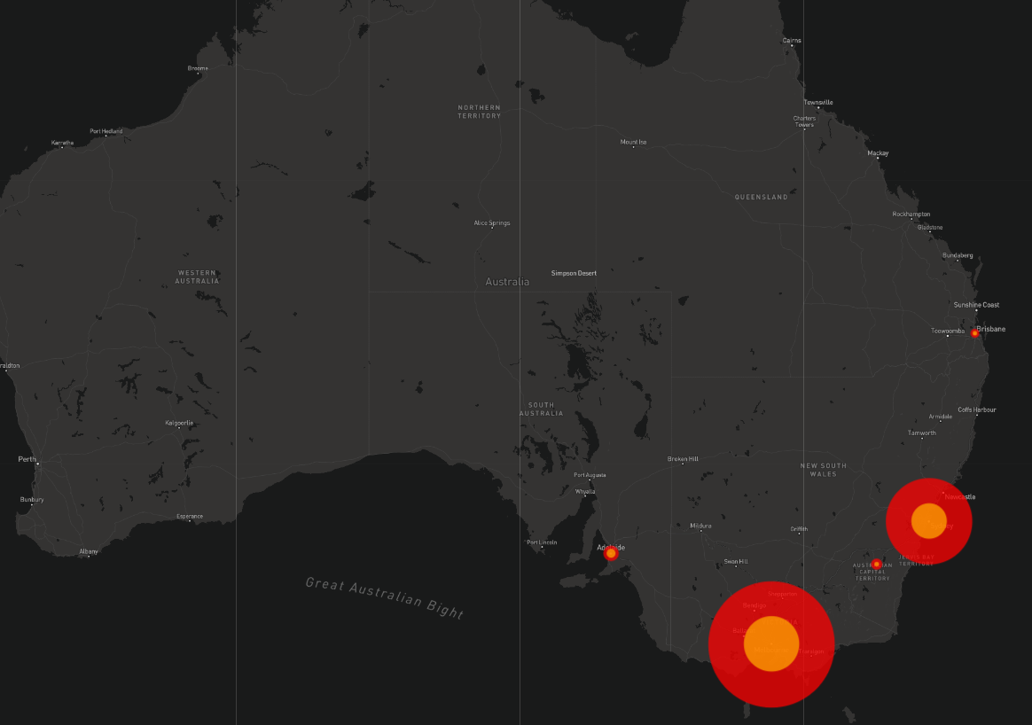
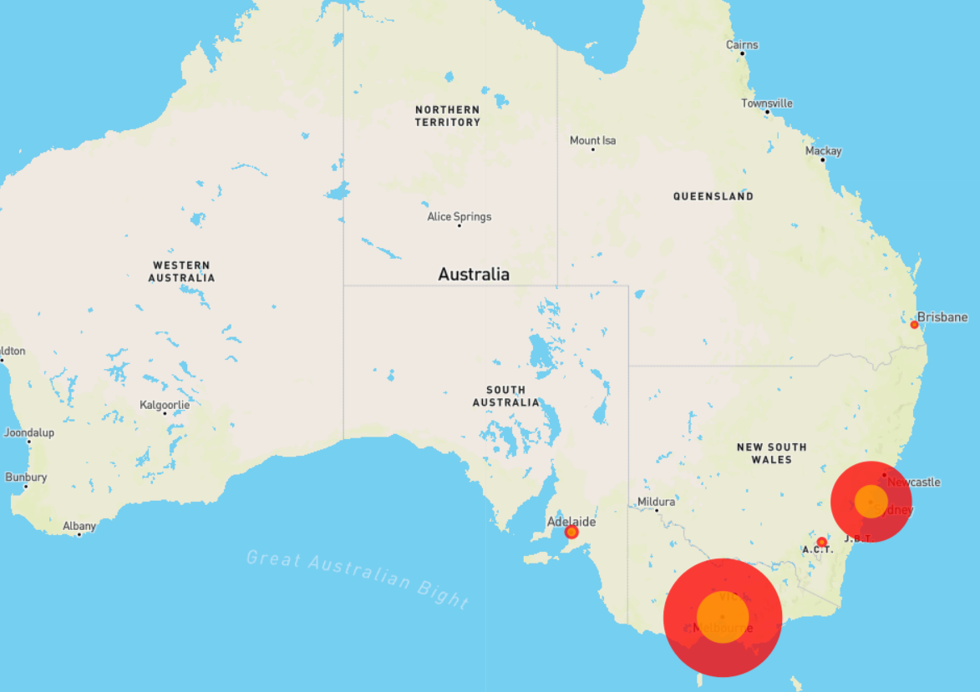
Visualisation 1:
Auction Clearance Rate Results – Eastern Seaboard Data
Outer Circle Pop-Up:
Inner Circle Pop-Up:
Dark Map:
Street Map:

Slide 23

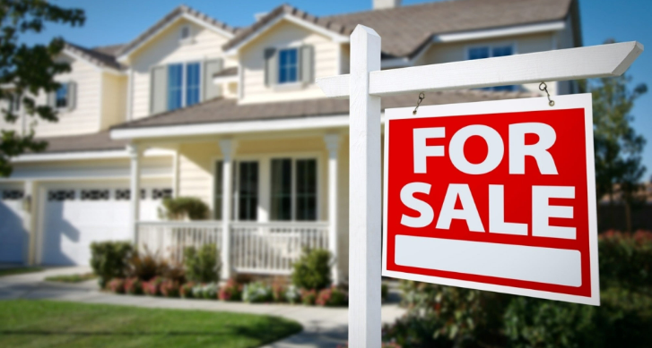
Visualisation 1:
Auction Clearance Rate Results – Eastern Seaboard Data
Findings:
Clearance Rates:
Brisbane 41% Sydney 41%
Canberra 46% Melbourne 45%
Adelaide 55%
All of the major cities on the Eastern Seaboard of Australia returned similarly poor clearance rate results.
The less expensive markets such as Brisbane, Canberra and Adelaide were not consistently higher or lower than their more expensive counterparts.

Slide 24
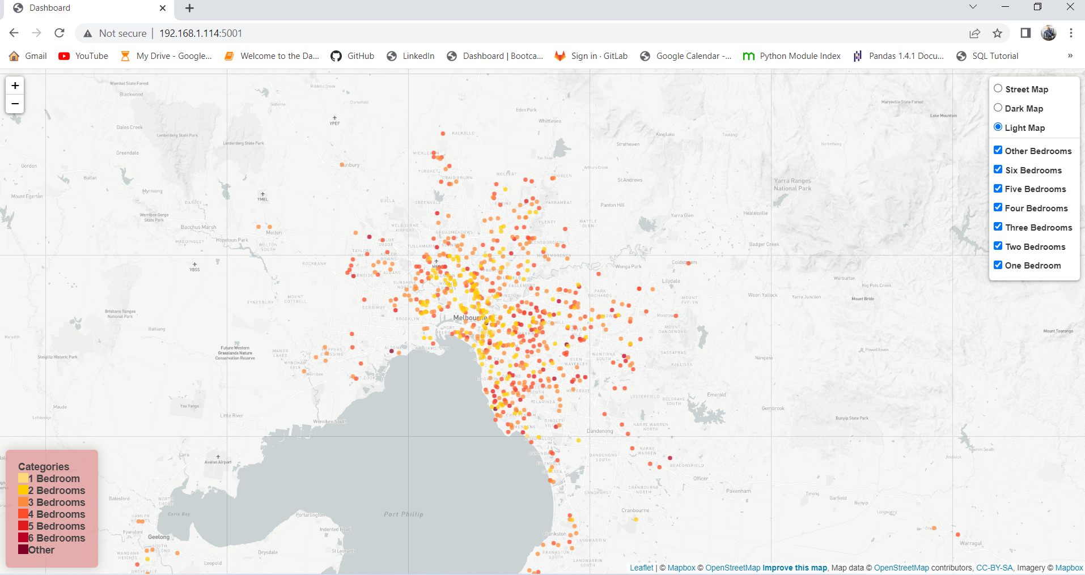
Visualisation 2:
Bedroom Numbers in Properties Sold in Melbourne
Hypotheses:
Sub-divisions of land, unit block developments and the construction of townhouses and duplexes have become increasingly popular over the last decade.
These trends will mean that the majority of homes with 1 – 3 bedrooms will be close to the CBD whilst those with 4 – 6 bedrooms will be in the middle to outer suburbs.

Slide 25
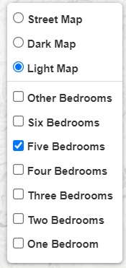
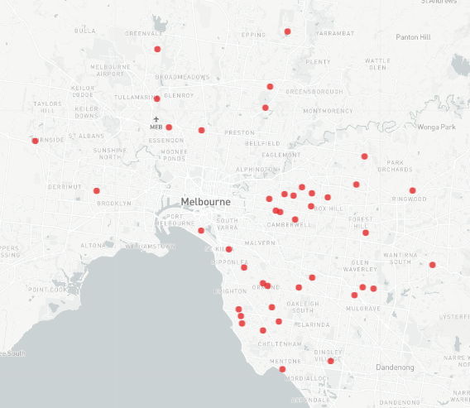



Visualisation 2:
Bedroom Numbers in Properties Sold in Melbourne
Bedroom Numbers on individual layers:
Legend:
Dark Map:
Street Map:

Slide 26






Visualisation 2:
Findings:
1 bedrooms – All bar one was in an inner city suburb.
2 bedrooms – Predominantly inner to middle suburbs. Heaviest concentration 5-15 kms from the CBD.
3 bedrooms – Even concentration in inner, middle and outer suburbs.
Bedroom Numbers in Properties Sold in Melbourne
Findings:
4 bedrooms – Most common in middle to outer suburbs.
5 bedrooms – Virtually none in the inner city suburbs. More in the 40-50km range from the CBD.
6 bedrooms – Rare in this day and age. Two in the outer-middle suburbs, and one in the wealthy inner suburb, Prahran.
1 bedroom
2 bedrooms
3 bedrooms
4 bedrooms
5 bedrooms
6 bedrooms

Slide 27

Clustered or Dispersed?
Visualisation 3:
Hypothesis:
There will be a higher number of sales in locations that are closer to the city centre.

Slide 28

Clustered or Dispersed: Findings
Visualisation 3:
Circa 700 properties sold via auction on the weekend.
41% within approximately 10km of the city radius.
47% within 10-20km city radius.
50% within (north-to-south) eastern regions, 25% in central regions and 25% in western regions.
Findings: The sale of properties via auctions is clustered within 20km city-radius, mainly in the eastern regions.

Slide 29

Agency
137 agency made trade in that week
This is top 15 agency

Slide 30


Slide 31


Data Limitations :
Bias in reporting sale price:
Reporting the sale price is not mandated.
It is in an agency’s best interest to only report favourable prices.
Limited data in certain suburbs made mean selling prices less reliable. More historical data could facilitate better mean calculations.
House prices are not simply linked to distance from the CBD, or the number of bedrooms. Facilities, transport infrastructure, schools and healthcare services also play their part. Our data did not provide information about these factors.

